Slide 1


Addressing the Impact of Political Instability on Insurance Penetration and National Resilience
Bernice Kamau & Rosemary Mwangi
Zamara Actuaries, Administrators & Consultants Ltd

Slide 2


Introduction
Political Violence and Terrorism:
Opportunity or Impending doom for insurers?

Slide 3
Outline
1
Background & Context
2
Key Findings from Sampled Dataset
3
Global Solutions
4
Role of Actuaries
5
Other Stakeholders

Slide 4
Background & Context:
Kenyan Insurance Industry - Key Insights
Market Share – African Countries
Market Share – African Countries
Top 5 Countries account for 87% of total Earnings
Notes:
Sources: Market Share and Ranking – Ecofin Agency Article dated 5 November 2024

Slide 5
Background & Context:
Kenyan Insurance Industry - Key Insights
Market Share – African Countries
Insurance Penetration per Year
Peak in 2016 at 2.8% | Lowest in 2020 at 2.2%
Notes:
Source: Penetration & GWP 2015 -2023 - AKI Annual Reports 2015 & 2023; 2024 Penetration Rate – Cytonn Report H1 2024; 2024 GWP – IRA Q4 2024 Report

Slide 6
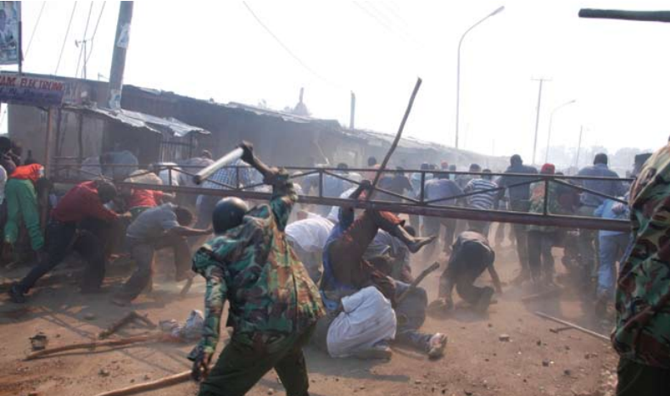
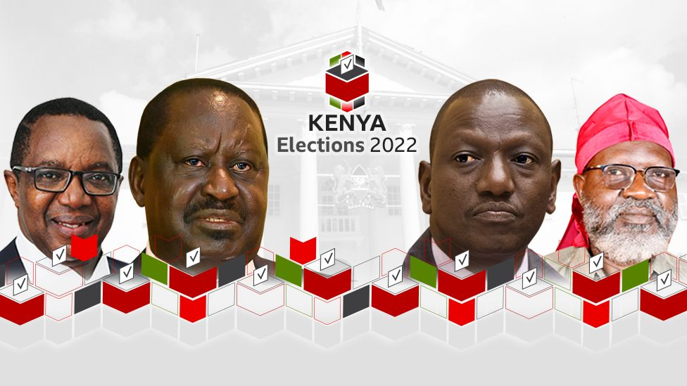
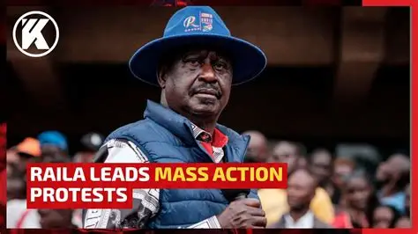

Background & Context:
Focal Events
2007
2022
Key Events
2023
2024

Slide 7
Background & Context:
2024 Finance Bill Protests
Timeline

Slide 8

Background & Context:
2024 Finance Bill Protests
Timeline
EARLY MAY
Introduction of Finance Bill
Early Calls for protests to reject the bill

Slide 9

Background & Context:
2024 Finance Bill Protests
Timeline
EARLY MAY
JUNE 18 & 20
Introduction of Finance Bill
Early Calls for protests to reject the bill
First Protests (Tuesdays and Thursdays)

Slide 10

Background & Context:
2024 Finance Bill Protests
Timeline
EARLY MAY
JUNE 18 & 20
JUNE 25
Introduction of Finance Bill
Early Calls for protests to reject the bill
First Protests (Tuesdays and Thursdays)
Bill in its final Parliamentary Stage
Major Protest
Occupy Parliament

Slide 11

Background & Context:
2024 Finance Bill Protests
Timeline
EARLY MAY
JUNE 18 & 20
JUNE 25
JULY 2
Introduction of Finance Bill
Early Calls for protests to reject the bill
First Protests (Tuesdays and Thursdays)
Bill in its final Parliamentary Stage
Major Protest
Occupy Parliament
Protests to reject killings
Demand resignation of President

Slide 12
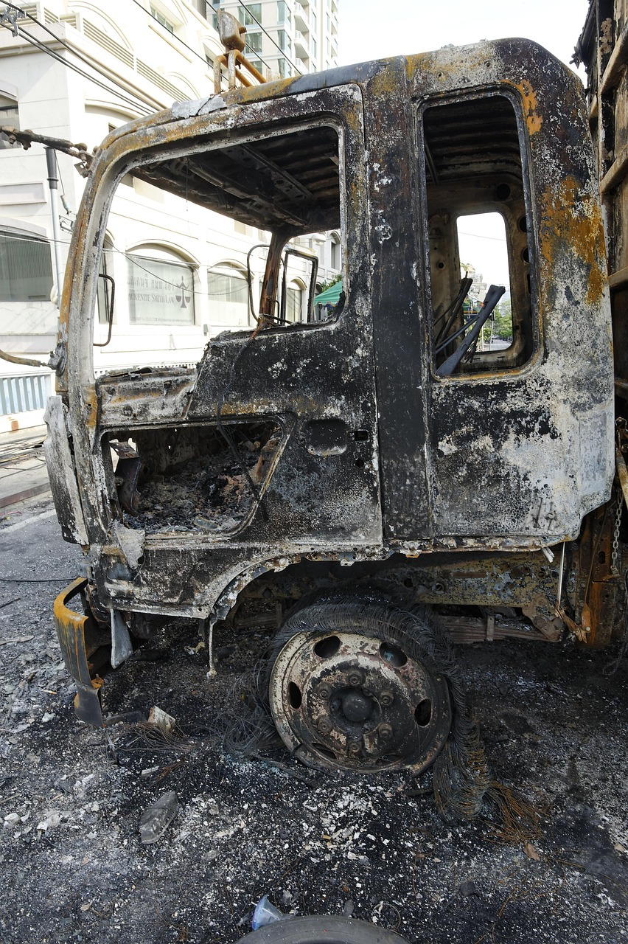
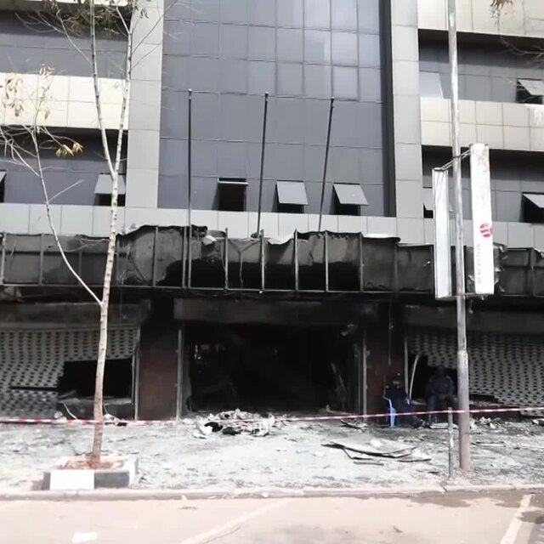
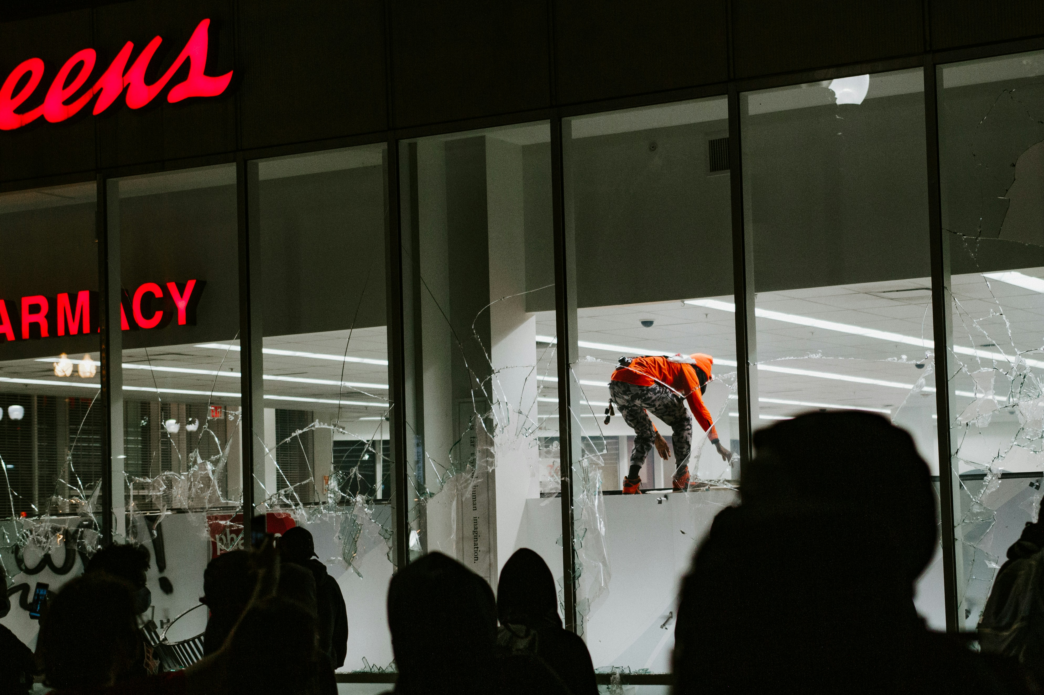



Background & Context:
2024 Finance Bill Protests - Impact
Looting
Property Damage
Arson
Loss of Income
Fear & Mistrust
Loss of Life

Slide 13
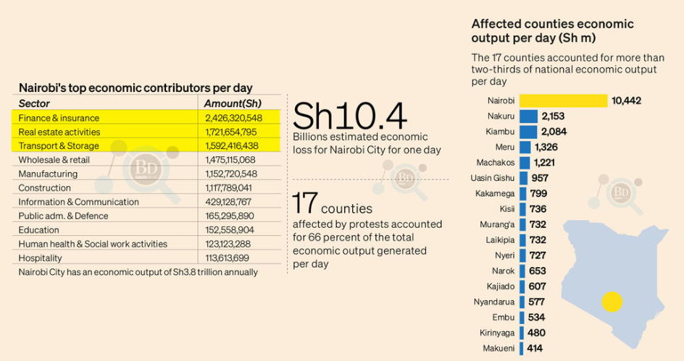
Background & Context:
2024 Finance Bill Protests - Impact

Slide 14
Background & Context: Kenyan Insurance Industry
Political Violence & Terrorism Rider
Fire Industrial
Motor Vehicle Insurance

Slide 15
Impact of Unrest: Key Findings From a Sample Dataset

Slide 16
Data
Source
Description
3 Select Insurers
Different Market Tiers
Premium
Claims
2006 - 2008
2022 - 2024
Motor Classes
Fire Industrial

Slide 17
Data
Key Assumptions
        Claims that occurred on the 25 June 2024 were largely due to protests
Limitations
        Availability of detailed claims description for some data
        Limited number of insurers
Credibility of Data
        Data may be biased due to loss date assumption

Slide 18
Methodology
Claim Identification: PVT data was isolated using specific loss dates (June 25 and July 2, 2024) to establish the main claim set.
Classification: Most claims were assigned to the Fire Industrial and Motor classes, aligning with AKI Findings that characterize PVT as a rider under Fire Industrial.
Data Selection: Insurer data was then filtered to focus exclusively on the Fire Industrial and Motor classes.
Analysis: The selected data, which included both claims paid and outstanding as well as premiums, was plotted to analyse the monthly fluctuations.
Time Periods: This analysis was conducted for the periods 2006 to 2008 and 2022 to 2024.

Slide 19
Key Insights – PVT Data
Observations from actual PVT Policies & Claims
For one of the selected insurers, policies bought after 25 June 2024 accounted for 48% of total policies bought for the year.
For two of the selected insurers, the claims from the 25 June protests accounted for about 17% of the total actual Political violence and Terrorism claims.
These Protest claims increase the total PVT claims by 20%.

Slide 20
Historical Context (2006 – 2008)
Spike in December ~ General elections held on 27th December 2007
Rise in claims in January with a peak in March 2008 ~ End of the PEV on 15th March 2008
Suggests correlation between political unrest and a spike in claims.
1
2

Slide 21
Contemporary Analysis (2022 – 2024)
Claims Experience
2
Spikes Observed:
June 2022 ~ Riots leading up to the August 2022 elections
April 2023 ~ Azimio la Umoja protests due to hiked cost of living
June 2024 ~ Finance Bill Protests held on 18th ,20th with a peak on 25th
Decline in claims suggests tightened underwriting practices
1
3

Slide 22
Contemporary Analysis (2022 – 2024)
Pricing Volatility
Spikes Observed:
July 2022 ~ After Riots leading up to August 2022 elections
May 2023 ~ After Azimio la Umoja protests
July 2024 ~ Following Finance Bill Protests held on 18th ,20th with a peak on 25th
Spike in premiums after major political unrest implies increased exposure as well as pricing reviews to reflect higher premiums due to exposure
3
2
1

Slide 23
Global Risk Framework: Who Bears The Shock?

Slide 24
Global Solutions: Risk type vs Mandate
Mandatory
Federal/Discretionary Backstop
Political/
Man-made
South Africa (SASRIA)
United States (TRIA)
Risk Origin
Turkey (DASK)
(National Disaster Insurance Institution)
France and Spain (Public-Private Partnerships)
Natural
Catastrophe
Mechanism Mandate

Slide 25
Case Study:
South Africa Special Risks Insurance Association (SASRIA)
Policyholder
Broker/Agent
Primary Insurer
SASRIA
Claim
Claim
Claim
Premium
Premium
Premium
SASRIA Confirms and settles claim directly to policyholder

Slide 26
Our Role

Slide 27
Role of Actuaries
Addressing Climate – Political Risk Intersection
Advising Governments & Regulators
Pricing & Reserving for black swan events
Model & Quantify Political Risk

Slide 28
Other Stakeholders

Slide 29
Other Stakeholders
Product Innovation
Voice in Policy Discussions
Public Education during crises
Enhanced Disclosure Requirements

Slide 30

Any Questions?

Slide 31
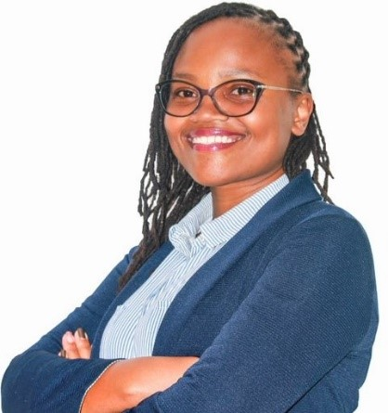

The Presenters
Rosemary Mwangi
Bernice Kamau
Senior Actuarial Analyst
Actuarial Analyst

Slide 32

Thank You!

