Slide 1


THE INTERSECTION OF ACTUARIAL PRACTICE AND INSURANCE REGULATIONS
EMERGING APPROACHES TO CAPITAL ADEQUACY, SOLVENCY & CONSUMER PROTECTION

Slide 2

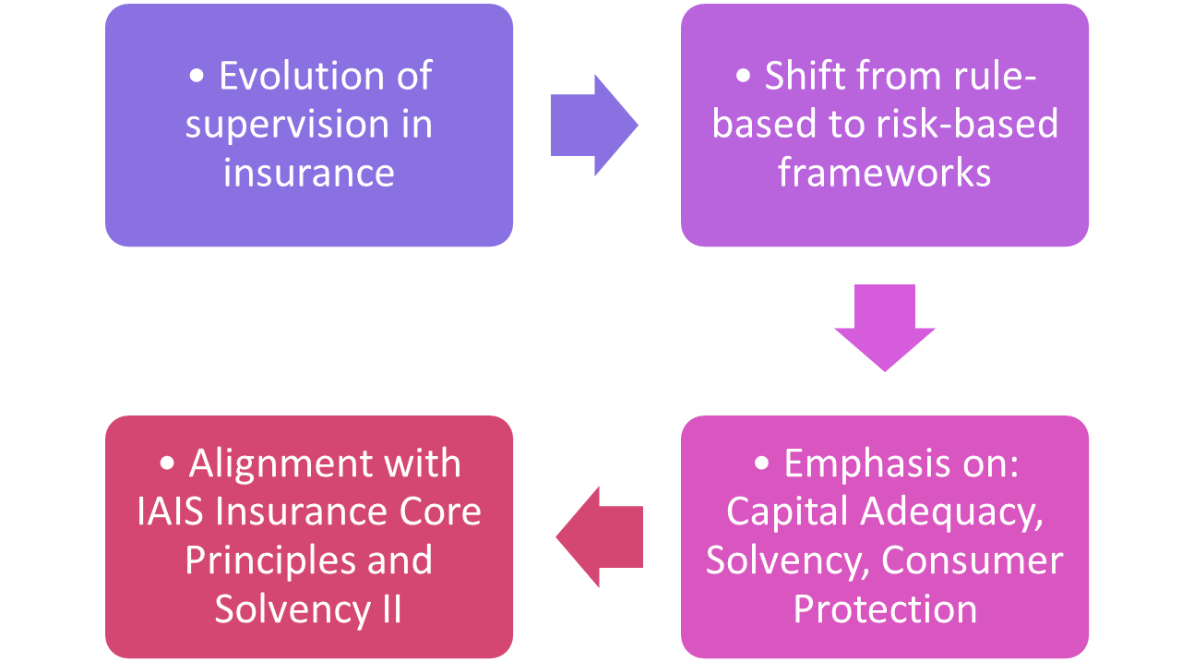
Overview

Slide 3

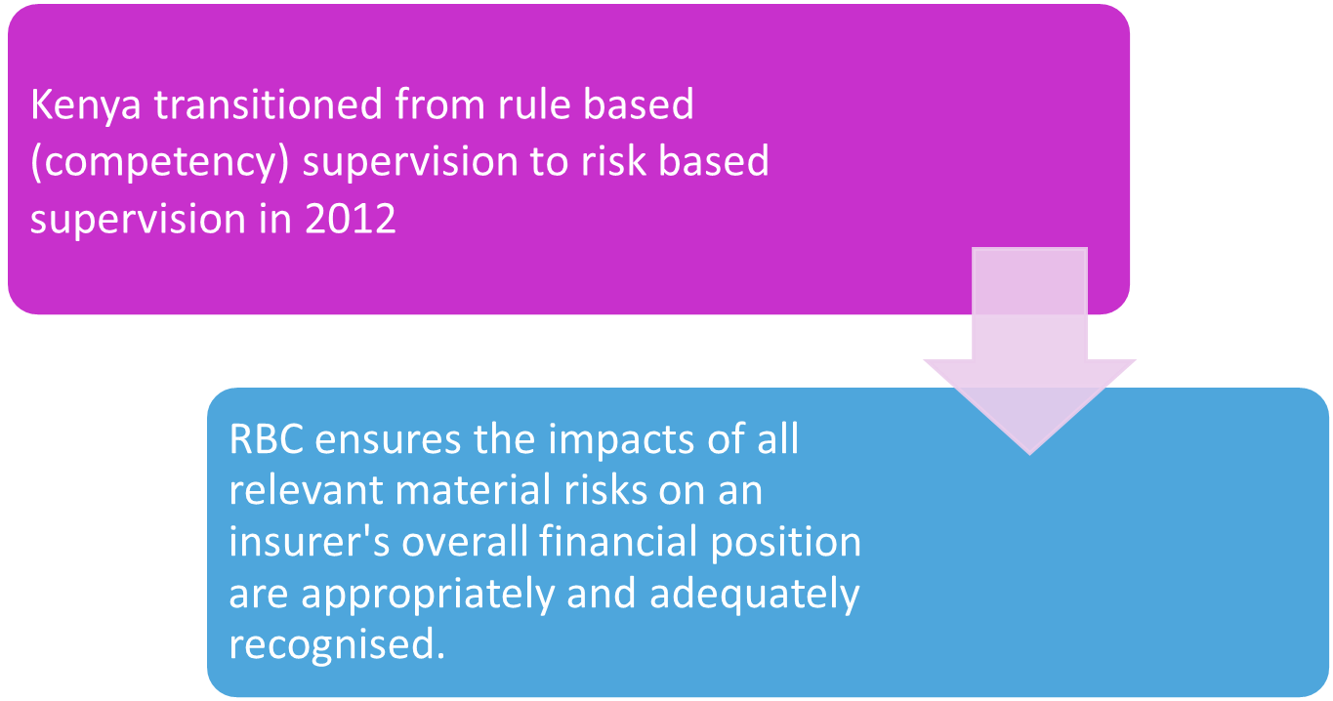

Evolution of Supervision in Insurance

Slide 4
Roles of Actuaries in Insurance Regulation
Risk identification and assessment
Capital adequacy and solvency assessment
Own risk and solvency assessment (ORSA)
Pricing and product governance
Enterprise risk management
Reporting and communication by preparing reports for boards, managements and regulators

Slide 5
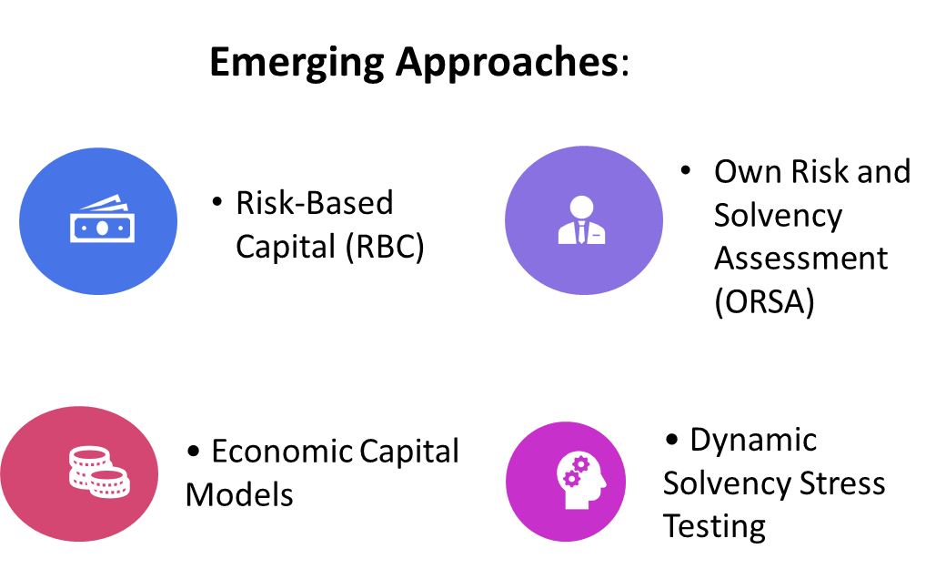
Emerging Trends in Capital Adequacy
Capital Adequacy ensures insurers hold enough capital to absorb losses and remain solvent.

Slide 6
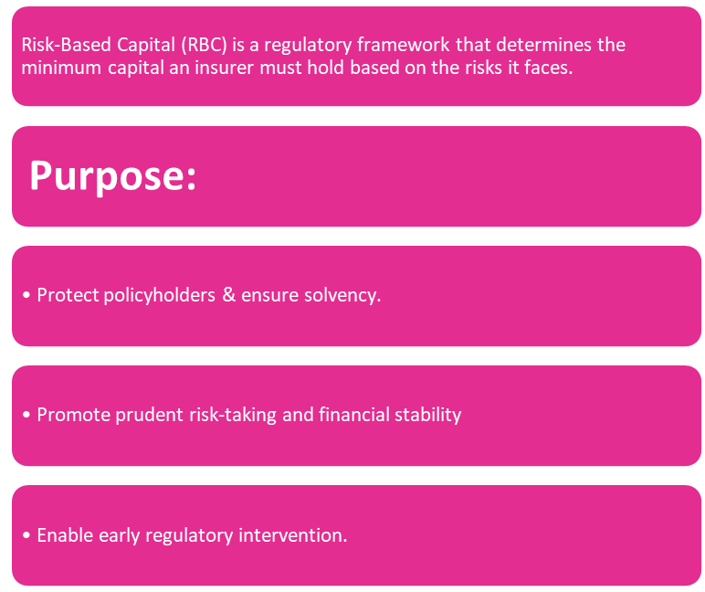
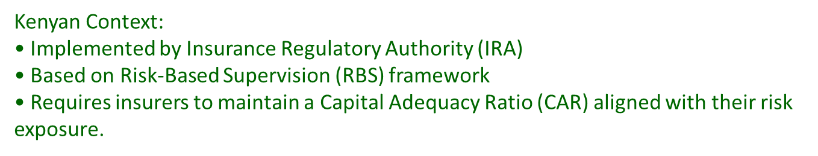
Risk-Based Capital (RBC): Linking Capital to Risk Exposure
How RBC Works
Risk Identification
↓
Risk Quantification
↓
Capital Charges per Risk Type
↓
Total Required Capital
↓
Avaliable Capital vs Required Capital
↓
RBC Ratio = (Available / Required) × 100%

Slide 7
Own Risk and Solvency Assessment (ORSA)
ORSA is an internal assessment by an insurer of the adequacy of its risk management and the sufficiency of its capital resources to ensure it can meet policyholder obligations at all times — both under normal and stressed conditions.

Slide 8
Own Risk and Solvency Assessment (ORSA)
Benefits
Forward-looking, self-assessment process
Links solvency needs to business strategy
Promotes proactive capital management
Outcome
Strengthened internal governance and risk culture.

Slide 9
Economic Capital & Dynamic Stress Testing
Economic Capital is the amount of capital an insurer estimates it needs to absorb unexpected losses with a specified confidence level over a given time horizon.

Slide 10
Economic Capital & Dynamic Stress Testing
Economic capital models aim to:
Measure the true financial strength of the company
Support strategic decision-making on pricing, reinsurance, investment, and product design.
Dynamic Stress Testing: Simulates macroeconomic, climate, and systemic shocks for long-term resilience assessments

Slide 11
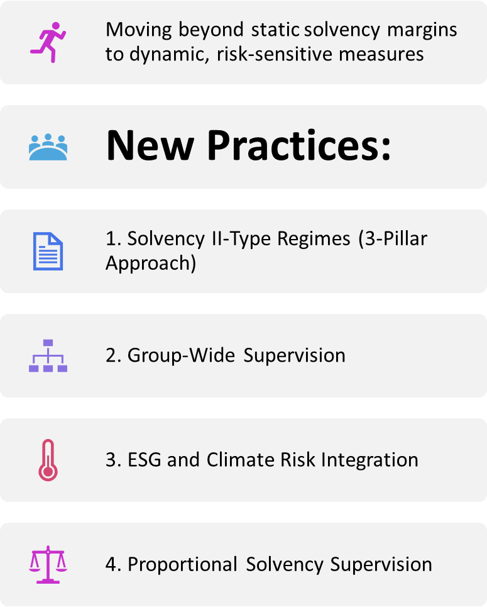

Solvency – Emerging Approaches

Slide 12
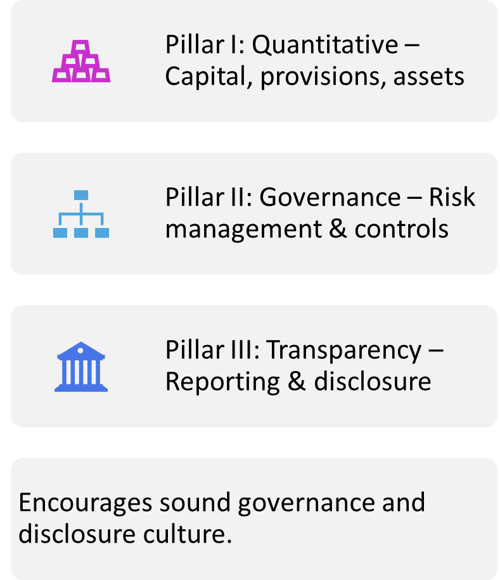
Solvency II Framework (Simplified)

Slide 13
Emerging Approaches to Consumer Protection
Shift from complaint handling to market conduct supervision.
Key Areas:
Fair treatment of customers
Product transparency & disclosure
Digital data protection
Financial literacy & inclusion

Slide 14



Market Conduct Supervision
Monitors product design, sales, and claims handling
Prevents mis-selling and delays in claims
Kenya: IRA Market Conduct Guidelines introduced
Goal: Trust and confidence in insurance market

Slide 15
Other Emerging Issues
Digital & Data Protection: Rise of InsurTech requires digital safeguards.
Micro-insurance
Emphasis on customer consent, data privacy and cybersecurity controls.
Actuarial Certification of reinsurance arrangements
IFRS 17

Slide 16
Conclusion
Regulatory shift toward risk-based and consumer-centric supervision.
Strong alignment with international best practices (IAIS, Solvency II)
Financially resilient insurers and protected consumers in a dynamic market.

Slide 17


