Slide 1


HOW AV'S ARE REVVING UP CHANGES IN AFRICA
Chris van der Merwe

Slide 2

Imagine you have ordered an e-hailing cab to take you to the airport, and a few minutes later a driverless taxi pulls up. Do you get in?
Yes definitely, what an adventure!
I’m indifferent, as long as I get there on time and don’t have to walk.
No way, I’m not putting my life in the hands of a computer thank you very much!

Slide 3
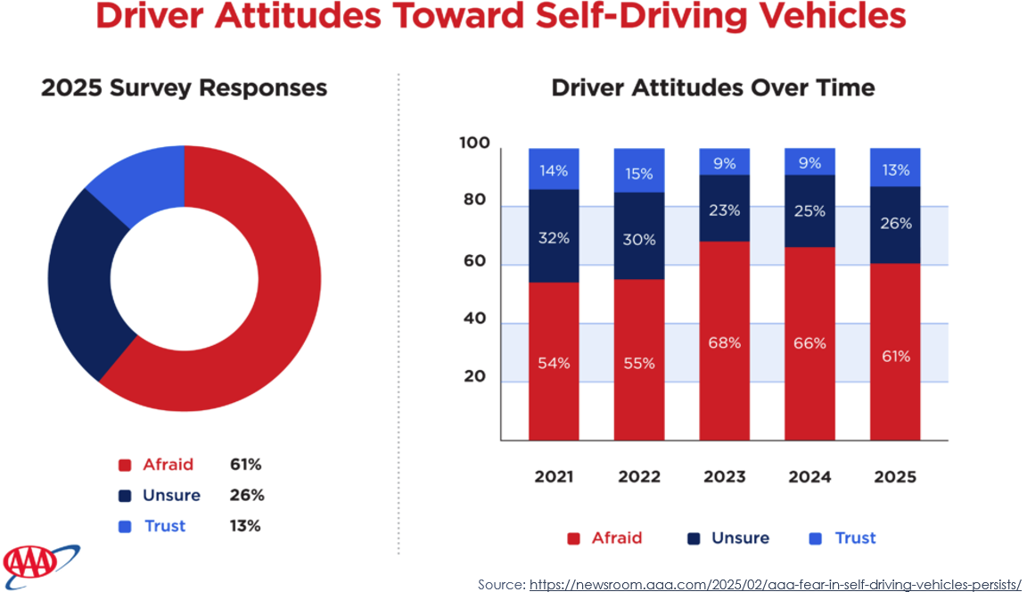

Slide 4

Latest AV developments

Slide 5
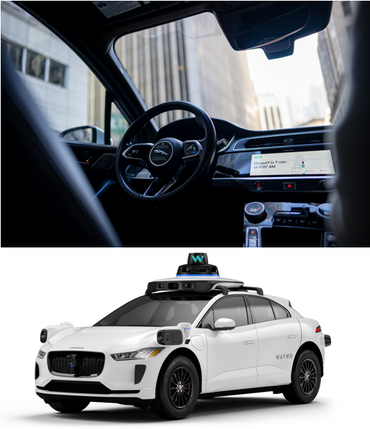
Waymo
Formally known as: Google self-driving car project.
E-Hailing service available through their mobile app.
Some areas integrated with Uber’s mobile app.
Operates in specific geographical zones.
> 250k autonomous rides per week.
Electric vehicles
Returns to base when requiring a recharge.

Slide 6
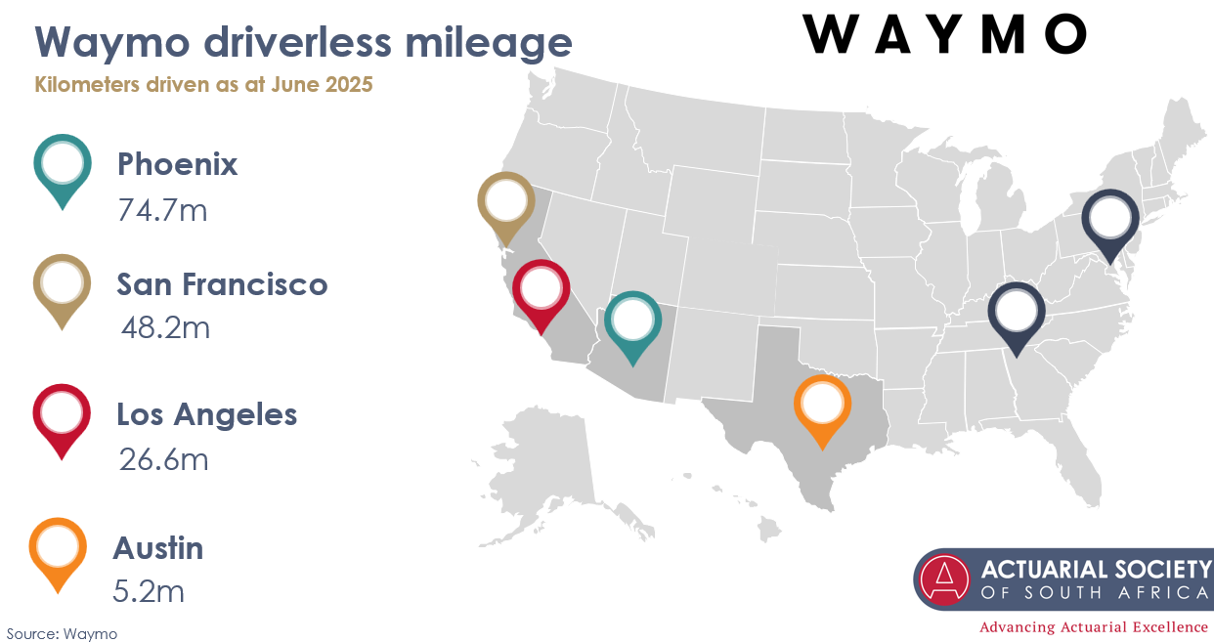


Slide 7
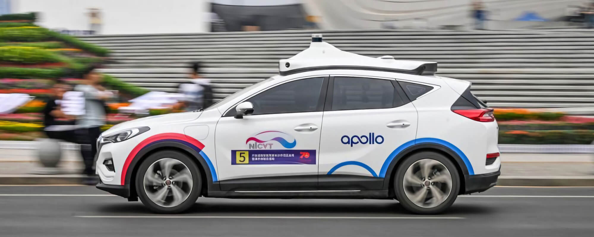
Apollo
Baidu’s Apollo offers autonomous service in China
Transitioned to fully driverless operations in Feb 2025.
Baidu’s fleet covered over 200 million kilometers as at mid-2025.
E-Hailing service available through Apollo Go app.
Aggressive expansion abroad through various partners:
Trials underway in Dubai (targeting 1000+ vehicles by 2028)
Europe, Australia, Southeast Asia, Turkey, Middle east
Delivering more than 170k autonomous rides per week.

Slide 8
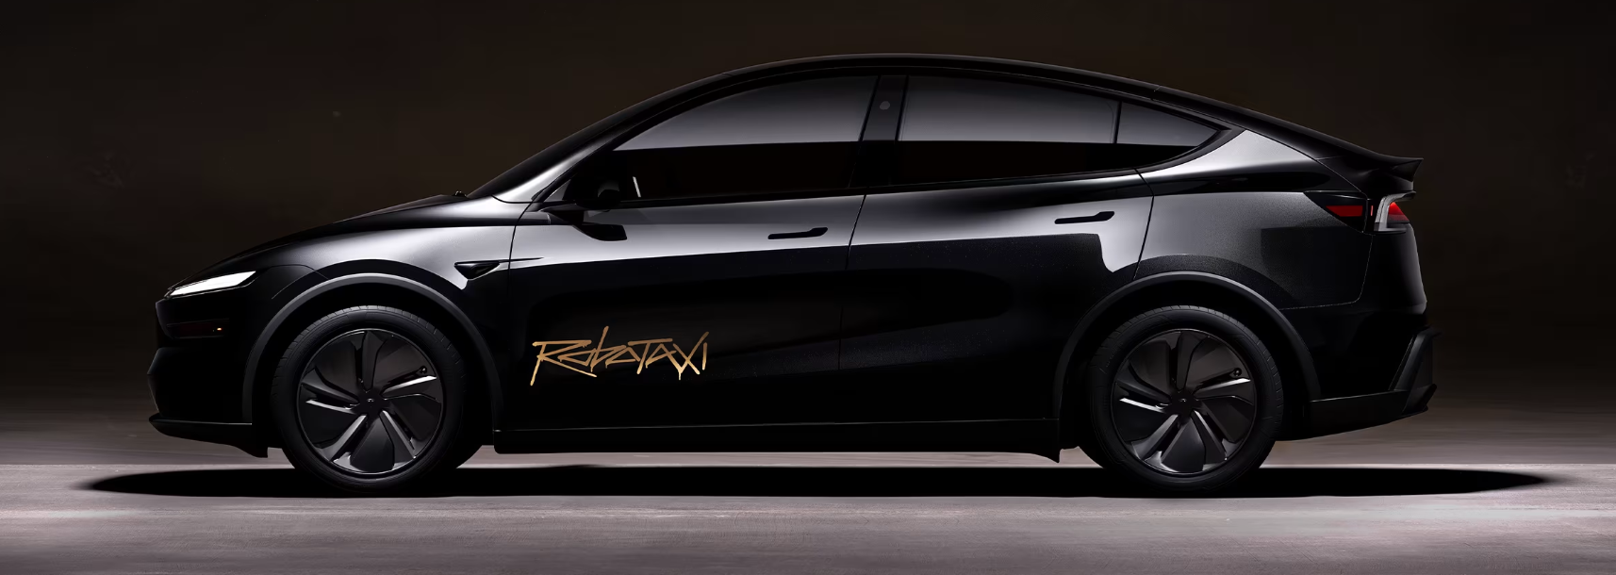
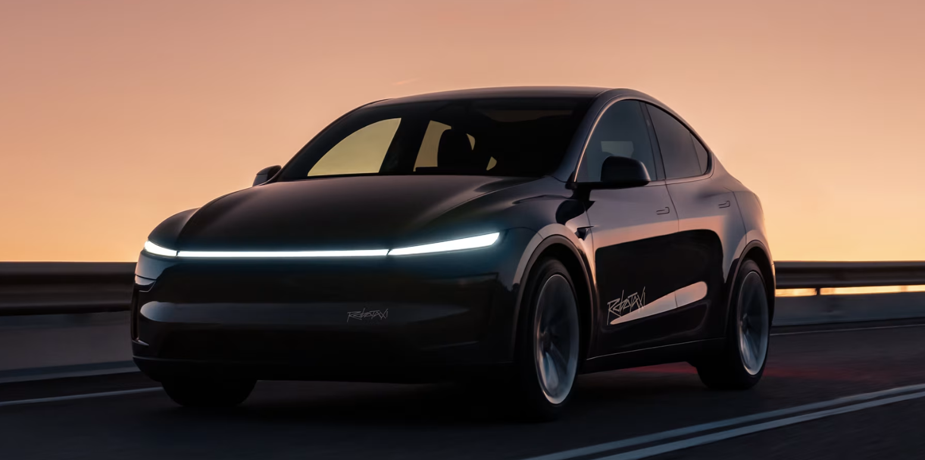
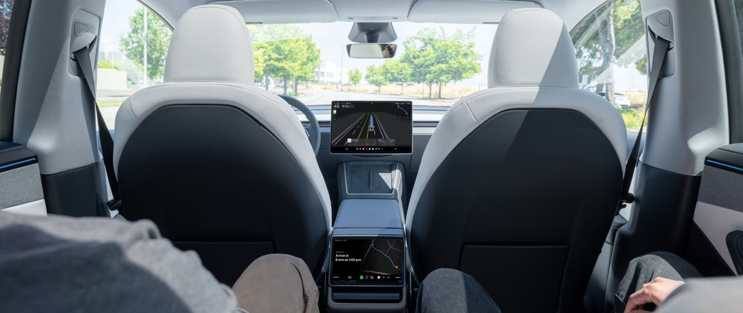
Tesla Robotaxi
Excitement when auto-pilot and FSD released
Request ride using their mobile application.
Limited to certain areas in Austin, TX.
Currently very low mileage.

Slide 9
Commercial
Trucks

Slide 10
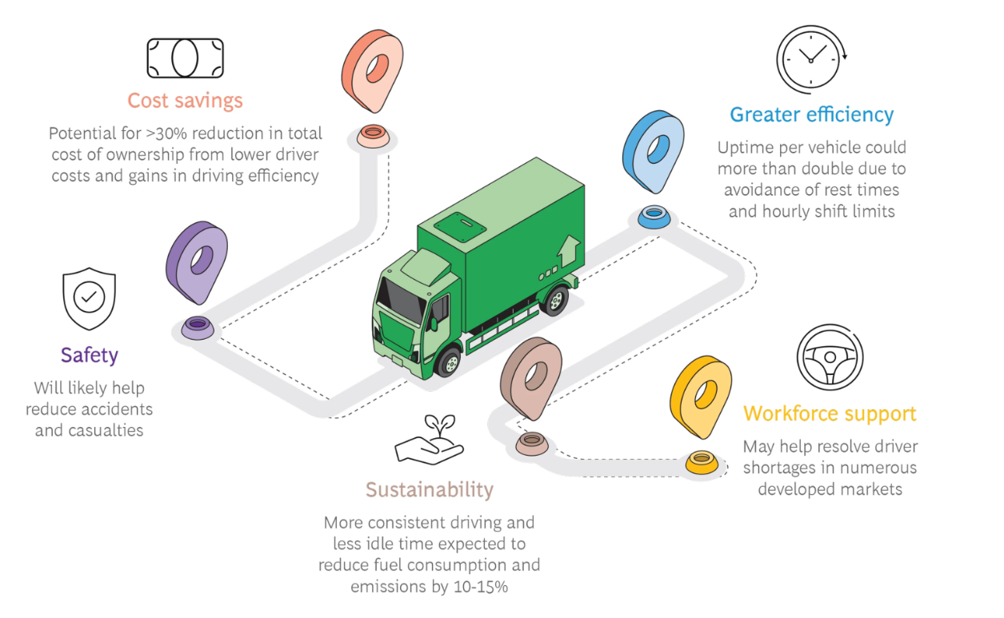

Slide 11

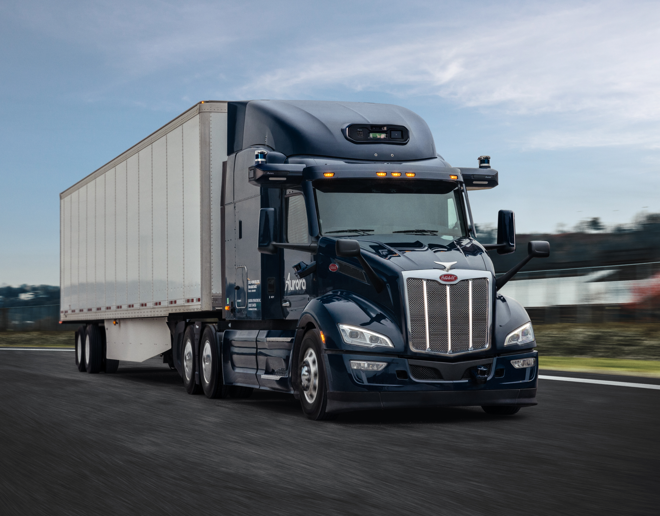
Aurora
Founded by industry veterans: Google, Tesla and Uber.
Primary focus on freight transportation.
Integrates with Class 8 trucks.
Hybrid:
Humans manage complex urban areas.
AI handles highway driving.
Mainly operate in Texas, USA.
3.3m commercial miles
(20k driverless June 2025).
Attempt to address current driver shortage in USA.

Slide 12
LEVELS OF AUTOMATION

Slide 13
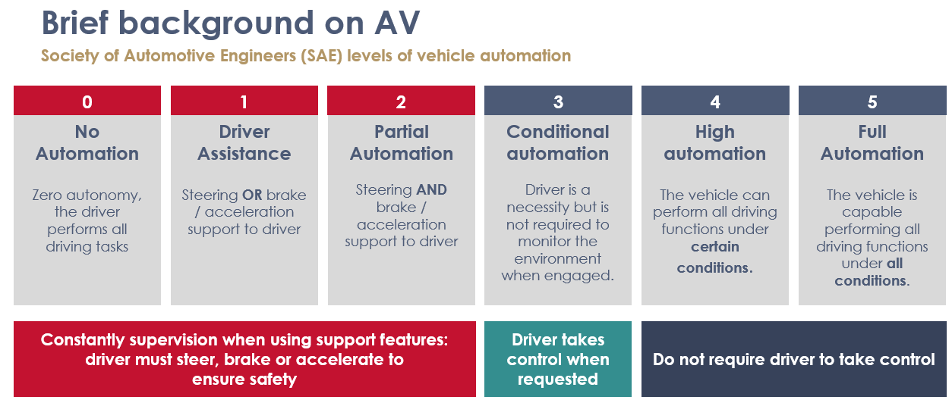

Slide 14
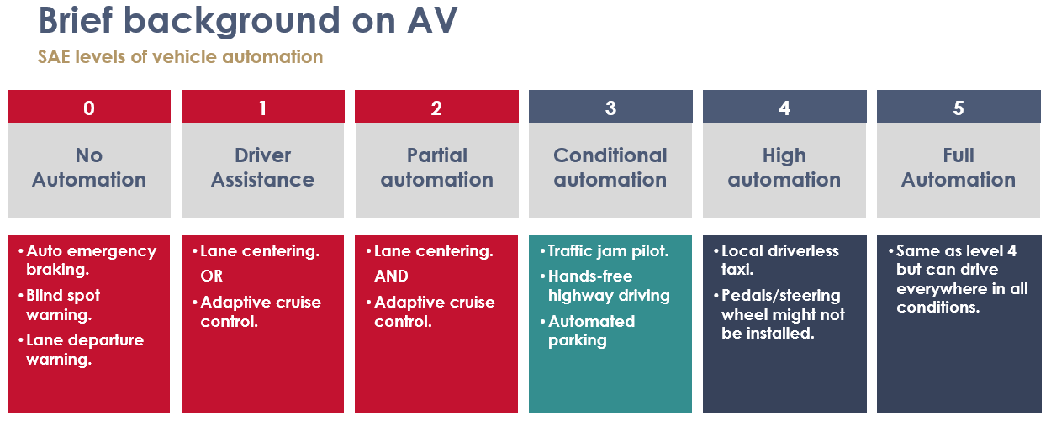

Slide 15
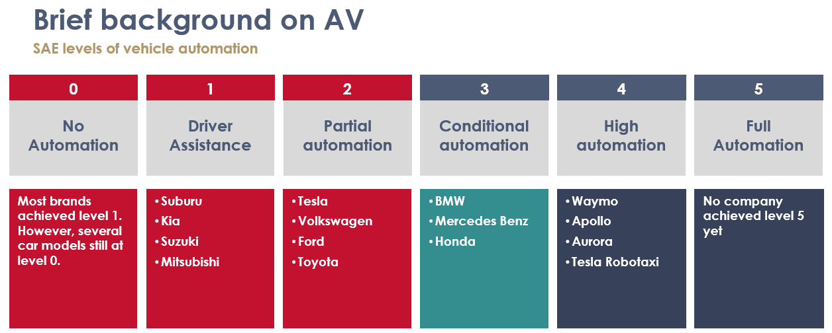

Slide 16
Software in an AV
Perception module – Process raw sensor data to generate representation of the environment for decision making.
Prediction module – Predicts future behaviour of other agents (e.g. pedestrians, cars)
Control module – Sends signals to vehicle (i.e., throttle, braking, steering)
Planning module – Determine navigation routes based on perception and prediction

Slide 17
HOW SAFE ARE AVs TRULY

Slide 18
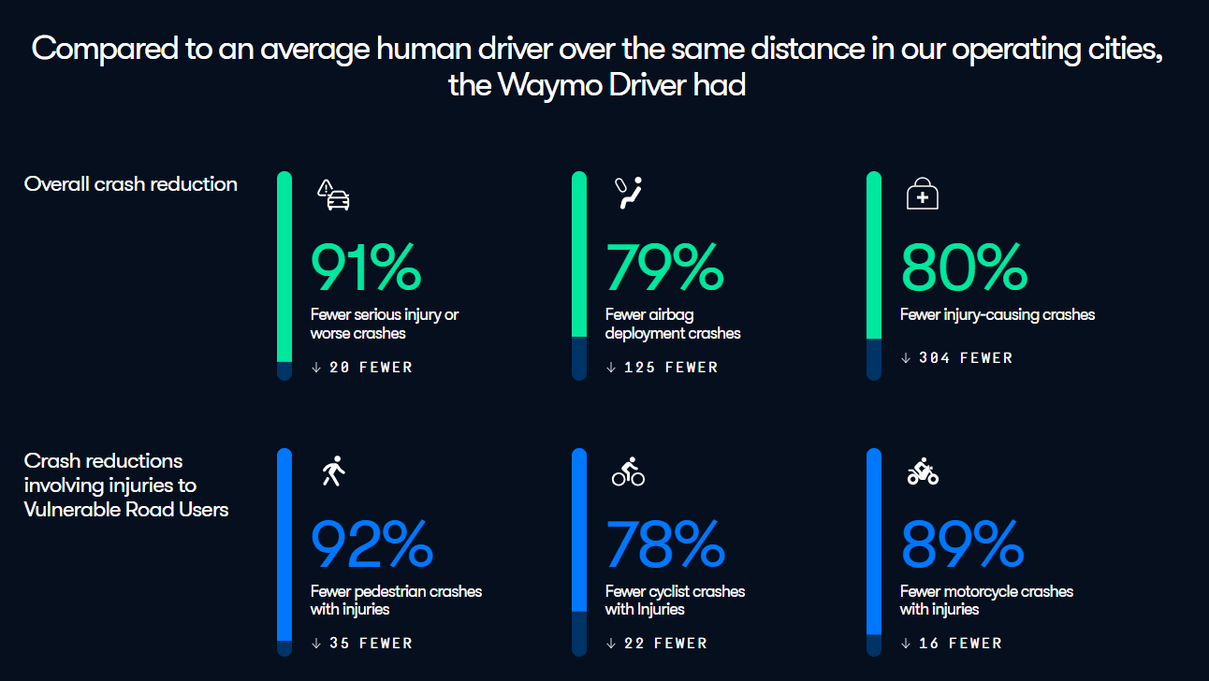

Source: https://waymo.com/safety/impact/

Slide 19
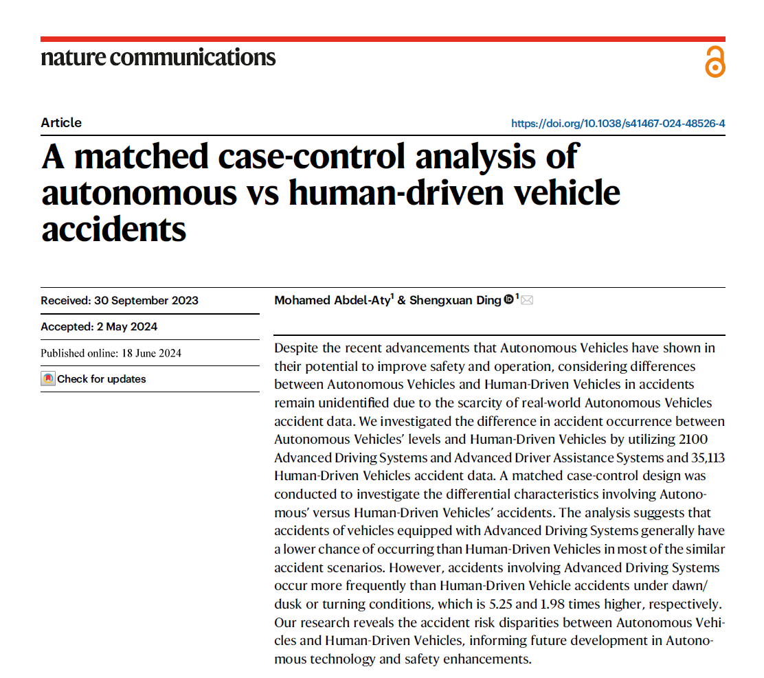
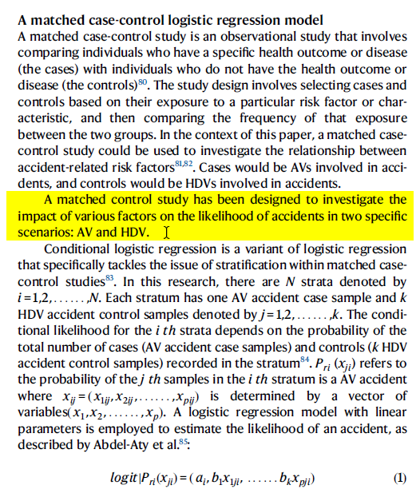
Studies on AV Safety

Slide 20
Studies on AV Safety
Matched case-control logistic regression model (typically used in health studies)
Select case/control based on exposure to risk factor/characteristic.
Next step: compare frequency of exposure between two groups.
Case group -> AVs involved in accidents
Control group -> Humans involved in accidents
Aim: compare differential characteristics of accidents involving humans / AVs

Slide 21
Studies on AV Safety
Segment 1:
AV crash data
Segment 2:
Human crash data
SAE level 4
N = 1099
SAE level 2
N = 1001
Human driver accidents
N = 35 133

Slide 22
Studies on AV Safety
Circumstance | Odds of AV compared to humans
Weather conditions:
Rain | 0.34
Low light (dawn/dusk) | 5.25
Accident type
Rear-end accident | 0.46
Broadside (T-bone) accident | 0.17

Slide 23
Studies on AV Safety
Circumstance | Odds of AV compared to humans
Pre-accident maneuver
Proceed straight | 0.30
Run-off road | 0.02
Entering traffic lane | 0.27
Turn | 1.99
Backing | 0.49

Slide 24
Unusual behaviour from AVs
Human collided with AV | % of accidents
Autonomous mode | 64%
Conventional mode | 36%
AV collided with human | % of accidents
Autonomous mode | 28%
Conventional mode | 72%

Slide 25
Challenges that remain
AVs to navigate new scenarios human drivers never seen.
Data remains limited.
Studies show hundreds of millions/billion miles required to prove safety.*
Reliable sensing and perception.
Robust system and reliable failsafe.
Robust decision-making algorithms.
*Source: Kalra, N. & Paddock, S. M. Driving to safety: How many miles of driving would it take to demonstrate autonomous vehicle reliability? Transp. Res. Part A 94, 182–193 (2016).

Slide 26
HOW TO QUANTIFY RISK

Slide 27
Approaches to quantify risk
Option 1
Option 2
Option 3
Do nothing
Infer AV impact from existing motor data
Use data available from AV studies

Slide 28
Infer AV impact from existing motor data
Contributing elements to human factors:
Jay-walking pedestrians
Speeding
Dangerous overtaking
Insufficient following distance
Driving under influence
Turn in front of oncoming traffic
Not following rules of road
Fatigue
Source: https://www.rtmc.co.za/images/rtmc/docs/reports/State-of-of-Road-Safety-Report---1-Jan-2023-to-31-Dec-2023.pdf

Slide 29
Infer AV impact from existing motor data
Contributing elements to human factors:
Jay-walking pedestrians*
Speeding*
Dangerous overtaking
Insufficient following distance
Driving under influence
Turn in front of oncoming traffic
Not following rules of road
Fatigue

Slide 30
Infer AV impact from existing motor data
“New” AV risks introduced:
Perception
  Misrepresenting actual environment
Predicting
  Misjudging behaviour of others
Planning:
  Speeding
  illegal maneuvers
  “Phantom braking”
Execution/Performance:
  Inappropriate vehicle control

Slide 31
FUTURE CHALLENGES

Slide 32
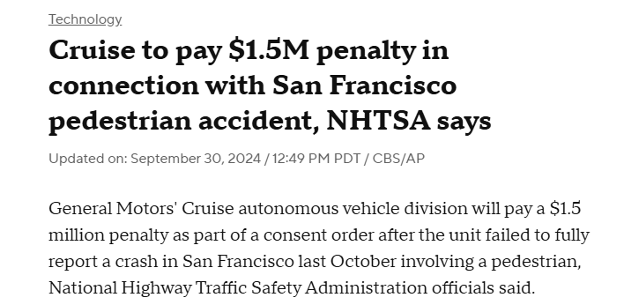

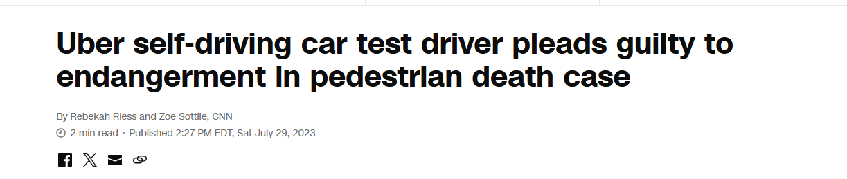
Future Challenges
Liability shifts – As automation reach higher levels, liability now moves to manufacturers. Is the human ‘co-pilot’ responsible too?

Slide 33
Future Challenges
Liability shifts – As automation reach higher levels, liability now moves to manufacturers. Is the human ‘co-pilot’ responsible too?
Tech innovation > legal development – Road frameworks not drafted with AVs in mind.
Data ownership, access, privacy – It’s unclear who owns this data which complicates fault determination.
Cyber security – Unauthorised access to AVs connected to the internet.

Slide 34
Future Challenges (Insurer specific)
Claims process transformations
  Shift to a more objective, data-driven approach.
  Less reliance on witness accounts.
Safety and consumer protection
  AVs are a new concept. Public trust is easily broken (higher level than humans).
New insurance needs
  Car manufacturers require liability insurance.
  Easier to sue car manufacturers.

Slide 35
Future Challenges (SA specific)
> SAE level 2 not available.
Production vehicles >= SAE level 3 rolled out in other developed markets (restricted functionality).
Likely to see more automation roll out to South Africa over time.
  Likely decrease in frequency and severity of motor claims.
  SA specific challenges remain.
  >= SAE level 4 likely several years/decades away

Slide 36
Future Challenges (SA specific)
High Unemployment – AVs (especially trucks) threatens job cuts. ‘Non-zero’ chance to lead to riots/protests and strikes.
Theft, vandalism and security vulnerabilities
  Expensive sensors, cameras and batteries in AVs increases this risk.
Economic and accessibility barriers
  Affordability hinder AV adoption.
  Connectivity issues (require constant internet connection)

Slide 37
Future Challenges (SA specific)
Road conditions – Potholes, unclear markings, inconsistent maintenance, traffic lights etc.
Low road law adherence – Difficulty predicting other agents’ behaviour
  Pedestrian behaviour (jaywalking behaviour).
  Ignoring signals on the road.
  Unusual driver behaviour locally.
  Side effect: human driver behaviour changes.
Loadshedding / Electricity shortage – Most AVs are in the form of EV vehicles

Slide 38


