Slide 1


Actuarial Governance of Agentic AI in Insurance
By Brighton Chitsiku, Senior Actuarial Specialist, The Shard
JingYuan Gong, Manager, Data Science & Analytics

Slide 2

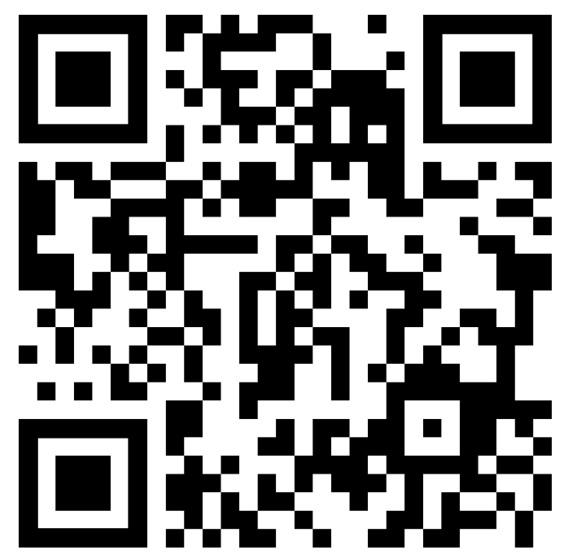
Agenda
01
Artificial Intelligence in Insurance
02
AI in Insurance: Risk
03
AI in Insurance: Policy and Governance
Link to Paper

Slide 3

Artificial Intelligence in Insurance

Slide 4
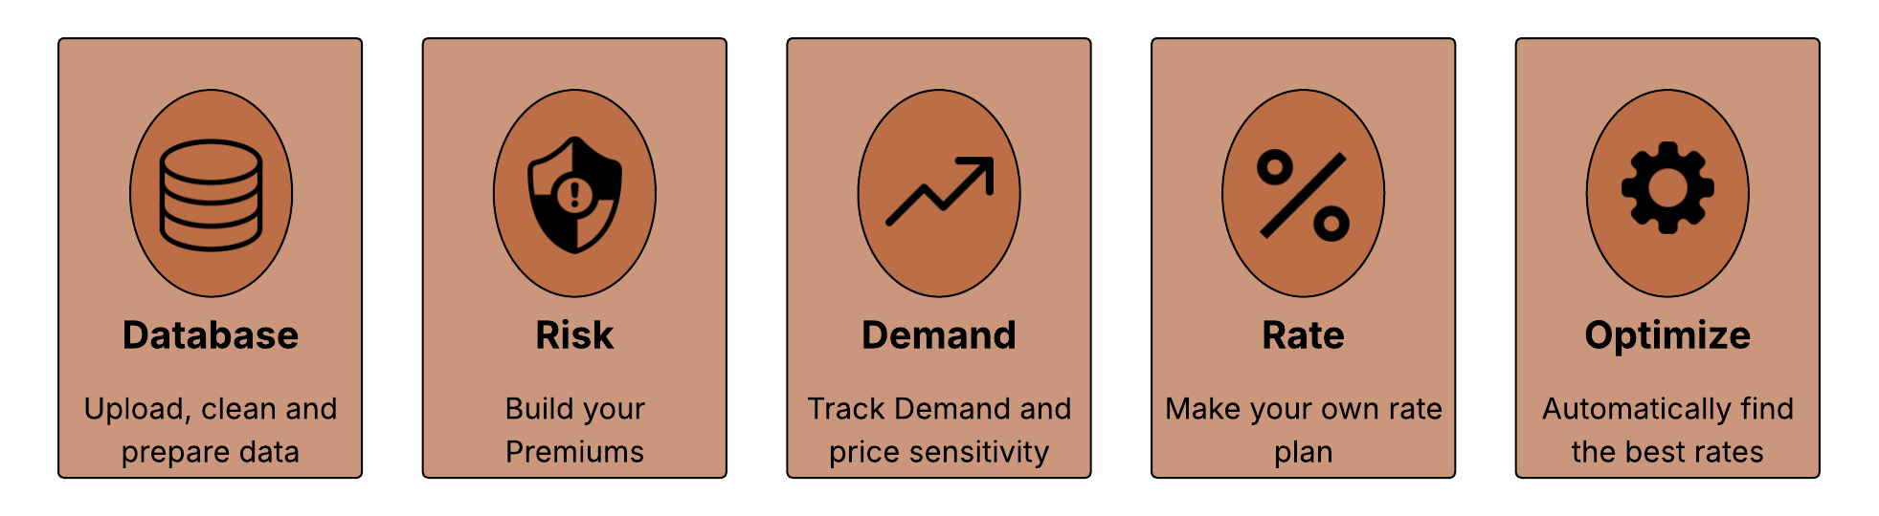
Akur8:
Transparent AI for Non-life insurance pricing

Slide 5



MasteryHive AI
  Intelligent Claims Processing
  Advanced Fraud Detection
  Automated Assessment & Settlement

Slide 6
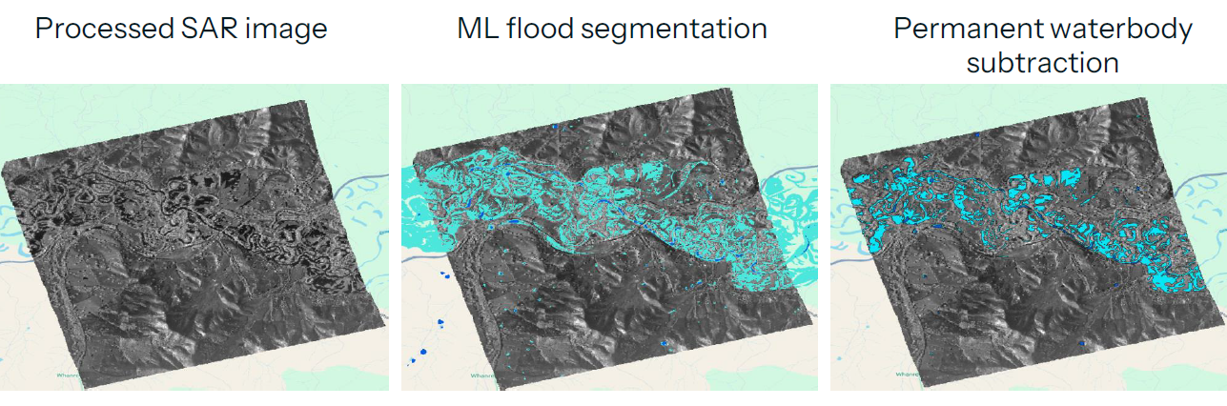
ICEYE- Synthetic Aperture Radar Imagery for Actuarial Reserving
Source: ICEYE

Slide 7
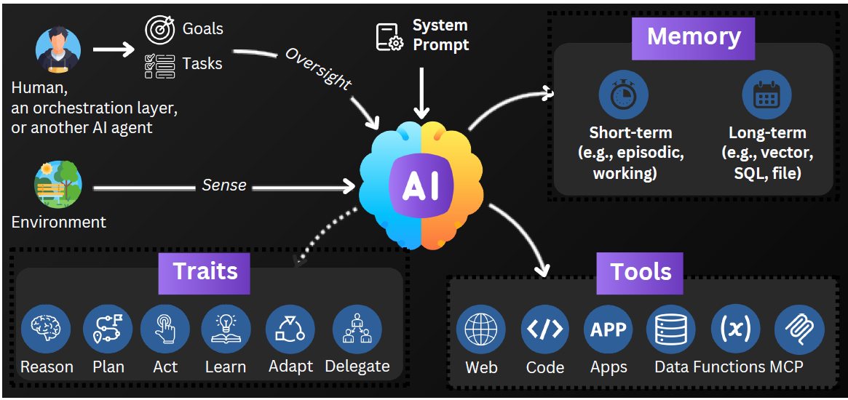
What is Agentic AI

Slide 8
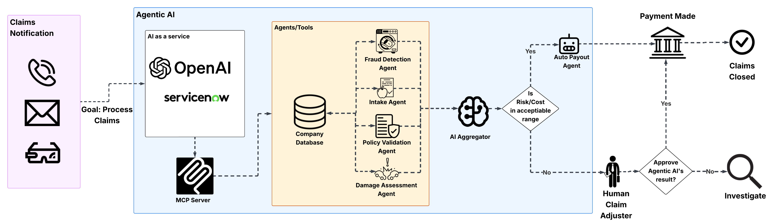
Agentic AI in Claims Processing

Slide 9
AI in Insurance: Risks

Slide 10
Risks Arising from the Use of AI
Model Risk
Poor Generalization and Data Bias
Protection of Personal Information
Cyber risk: Fraud and AI Model Manipulation

Slide 11
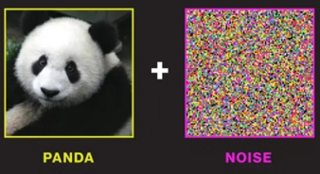
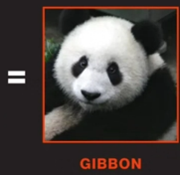
Model Risk
Bad model:
  Misclassifications, overestimations and underestimations of future claims amounts.
  Client disputes and potential legal challenges.
  Leads to losses that are difficult to explain and that are costly and time consuming to analyze.
Source: MIT Technology Review

Slide 12
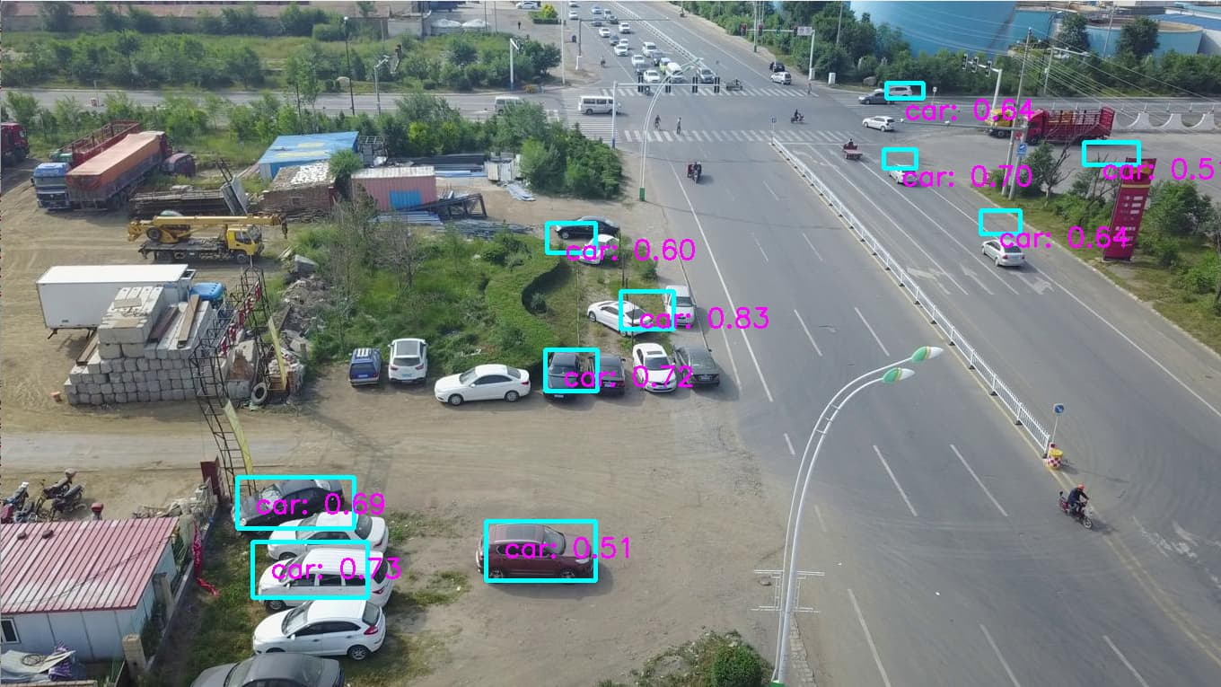
Poor Generalization and Data Bias
Out-of-distribution data leading to inaccurate model outcomes and reduced accuracy.
E.g. model trained using data from developed countries
This may result in bias against a group that is underrepresented in the training of the model.
Source: forums.developer.nvidia

Slide 13

Protection of personal information
Sharing of data:
  Feeding data to third-party AI provider (AI as a Service).
  Extra cost to anonymize data and the risk that this is not done correctly.
Alternative:
  Develop internal AI model.
  May come at a significant cost.
  Model may not perform as well as commercially available models.
This Photo by Unknown Author is licensed under CC BY-SA

Slide 14

Cyber Risk: Fraud and AI Model Manipulation
General cyber risks arising from:
  Bad cyber security practices.
  Use of Agentic AI’s and MCP protocols.
Model bias resulting in manipulation by users.
e.g., bias towards overestimation of claims for a particular group of policyholders may increase the risk of fraud.
This Photo by Unknown Author is licensed under CC BY-SA

Slide 15
AI in Insurance:
Governance and Policies

Slide 16
Company AI Risk and Governance Framework
Include AI risks within the company’s risk management framework.
Develop an AI Governance Framework to complement the risk management framework for AI risks.
The development should leverage existing standards and frameworks developed on the governance of AI e.g.:
  ISO/IEC 42001: AI Management System (Still under development)
  ISO/IEC TR 24027: Bias in AI
  ISO/IEC 29100: Data: Privacy framework for personally identifiable information
  Other data and AI governance frameworks e.g. Google’s SAIF

Slide 17
Developments within the AI Industry
Specific controls for what the AI model can and cannot do:
  e.g., Requiring human approval for claims above a certain threshold.
Retrieval Augmented Generation (RAG):
  Provides context to Large AI models by using localized data and information.
Reward Functions (RF):
  Reinforcement learning technique that measures how well the AI model’s decisions are aligned with expected outcomes.
  Assigns numerical values (rewards/penalties) which guide the model’s behaviour.

Slide 18
Regulation
Government Legislation:
  Slower development of legislation.
  For the insurance industry: focus on enforcing the ethical use of AI.
  e.g., European AI Act of 2024
Other governing bodies in Africa:
  African Union – Continental AI Strategy will likely influence future legislation.
  South Africa’s Financial Sector Conduct Authority’s (FSCA) 3-year regulation plan of 2024 on the use of AI by Financial Service Providers (FSP).
  South Africa National Artificial Intelligence Policy Framework: “Towards the Development of South Africa National Artificial Intelligence Policy”.

Slide 19
The Shard

Slide 20
About Us
Founded in 2013, The Shard is a consulting ﬁrm that capitalises on a rich diversity of skills and experience.
We offer Actuarial Consulting, Accounting Advisory, Risk Assurance and Advisory Services (RAAS), and Data Science & Analytics to our clients.
We solve our client’s problems by deploying a team of carefully selected human capital for each project. We leverage our diversity of skills, experience, and age to deliver best-in-class services across our various fields of practice.
OUR VISION
To be widely recognized for delivering groundbreaking solutions and unparalleled value for our clients.
OUR VALUES
Entrepreneurial, Agile, Integrity & Trust, Excellence, Collaborative Culture
OUR MISSION
Leverage multi-disciplinary expertise, experience and dynamic tools to collaboratively deliver groundbreaking solutions and unparalleled value.

Slide 21
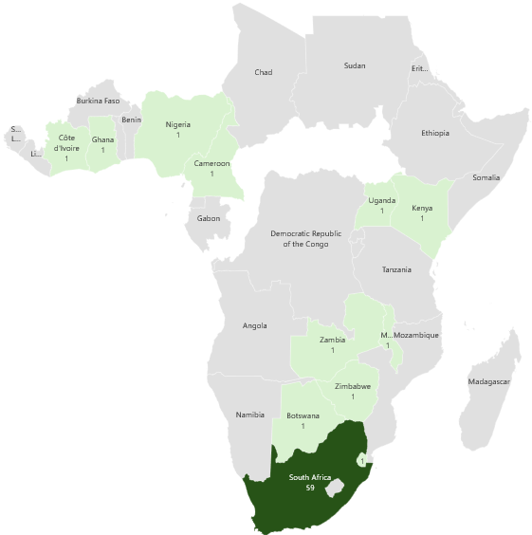
Contact Us
South Africa Address: Building B, 2nd Floor
1 Sturdee Avenue, Rosebank Johannesburg, 2196
Kenya Address: Office No 9,
Karen Village,
Nairobi, 00502
Email: info@theshard.co.za
Website: www.theshard.co.za
South Africa Telephone: +27 (0) 87 049 2302
Kenya Telephone: +254 72 6809545

Slide 22
Questions and Comments
Link to Paper

