Slide 1

From Calculators to Architects: The Actuarial Role in Shaping Market Disclosure
Presented by Henry Mbuthia
At The 10th Annual TASK Actuarial Convention 2025
Notes:
https://notebooklm.google.com/notebook/08820021-7dea-4aeb-82ce-fa84324cec33

Slide 2
Table of Contents
1. Defining Market Disclosure
2. Purpose / Role Of Market Disclosure
4. Categorisation Of Market Disclosures
5. Market Disclosure Metrics
6. Disadvantages / Risks Of Market Disclosures
7. Market Disclosure In Action
8. The Actuarial Role In Market Disclosure
9. A Case For Kenya
10. Conclusions And Recommendation
3. Users Of Market Disclosures
2

Slide 3
Defining Market Disclosure
3

Slide 4
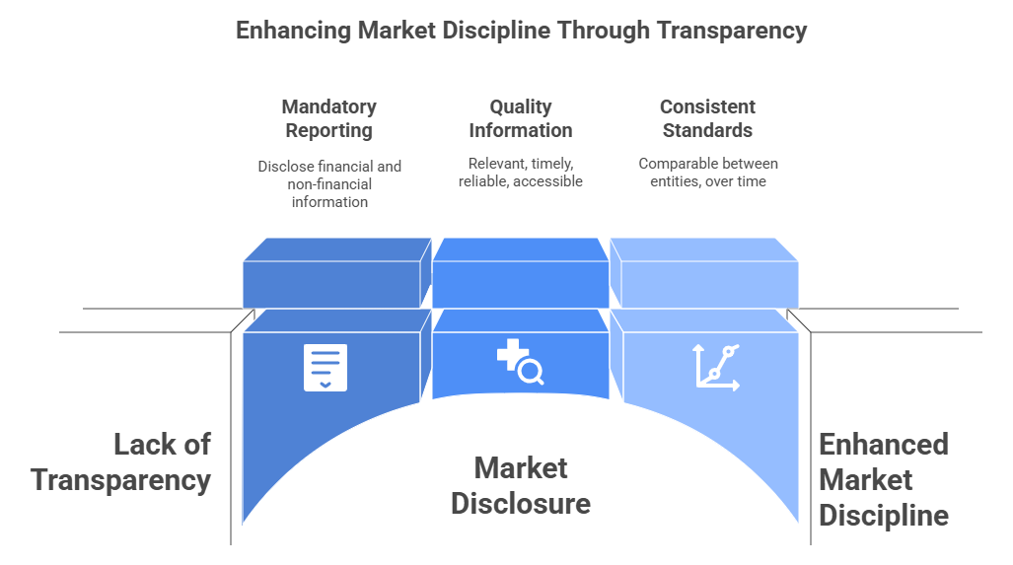
Defining Market Disclosure
Market Disclosure (MD), sometimes referred to as Public Disclosure (PD) or Risk Disclosure (RD), generally refers to the dissemination of information intended for stakeholders and participants in the relevant markets.
In regulated industries, particularly the financial sector, market disclosure is often mandated to achieve transparency and market discipline.
Notes:
https://notebooklm.google.com/notebook/91eed5e6-3220-4a1e-ae07-9f18a292d44b

Slide 5
Purpose/ Role of Market Disclosure
5

Slide 6
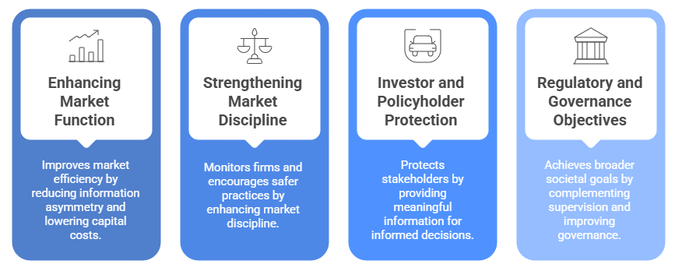
Purpose/ Role of Market Disclosure
The core purpose and roles of market disclosure are to foster transparency, enable market discipline, reduce information asymmetry, and provide stakeholders with the necessary information for informed decision-making.
Market disclosures improve market efficiency, corporate governance, stakeholder protection, and regulatory oversight.
Notes:
https://notebooklm.google.com/notebook/91eed5e6-3220-4a1e-ae07-9f18a292d44b

Slide 7
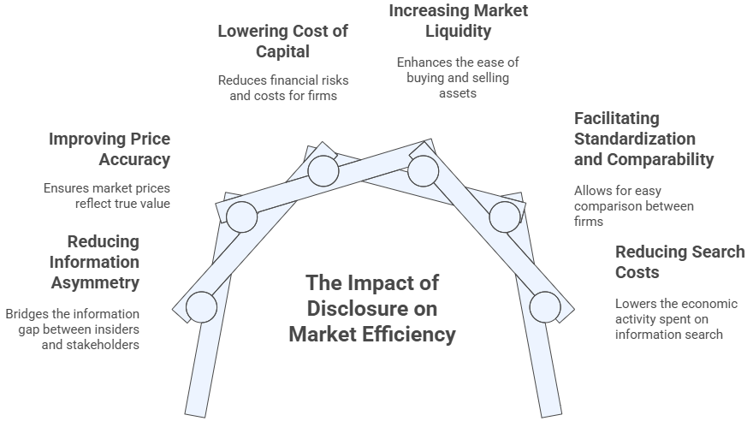
Purpose/ Role of Market Disclosure
Enhancing Market Function and Efficiency
A primary role of disclosure is to improve the functioning of capital and insurance markets by addressing fundamental economic issues.
Notes:
https://notebooklm.google.com/notebook/91eed5e6-3220-4a1e-ae07-9f18a292d44b

Slide 8
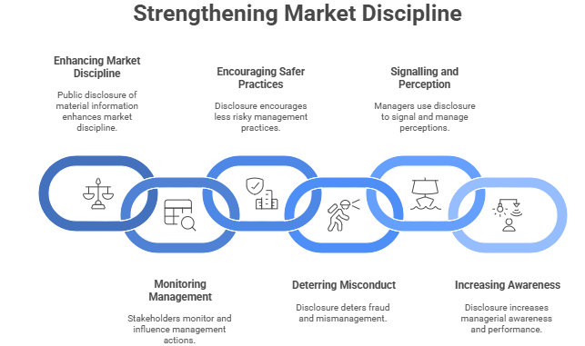
Purpose/ Role of Market Disclosure
2. Strengthening Market Discipline and Influencing Corporate Behaviour
Disclosure serves as a critical mechanism to monitor and discipline firms, particularly financial institutions.
Notes:
https://notebooklm.google.com/notebook/91eed5e6-3220-4a1e-ae07-9f18a292d44b

Slide 9
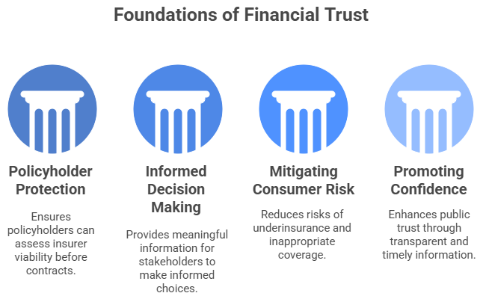
Purpose/ Role of Market Disclosure
3. Investor and Policyholder Protection
In financial services, where customers are buying a promise of a future benefit, disclosure is vital for stakeholder protection.
Notes:
https://notebooklm.google.com/notebook/91eed5e6-3220-4a1e-ae07-9f18a292d44b

Slide 10
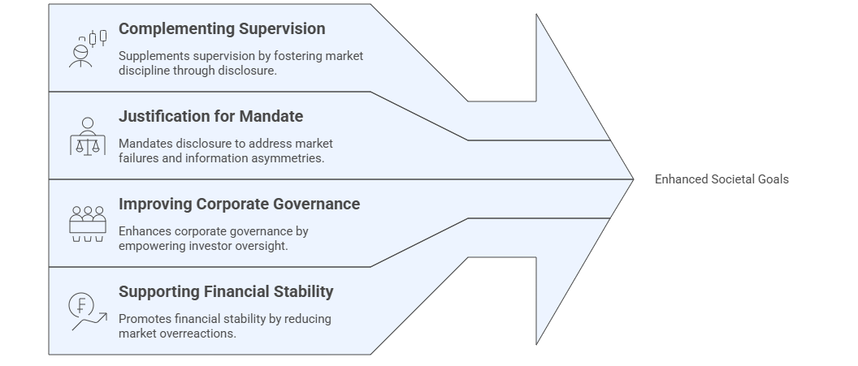
Purpose/ Role of Market Disclosure
4. Regulatory and Governance Objectives
Mandatory disclosure is a significant public policy tool used by regulators to achieve broader societal goals.
Notes:
https://notebooklm.google.com/notebook/91eed5e6-3220-4a1e-ae07-9f18a292d44b

Slide 11
Users of Market Disclosures
11

Slide 12
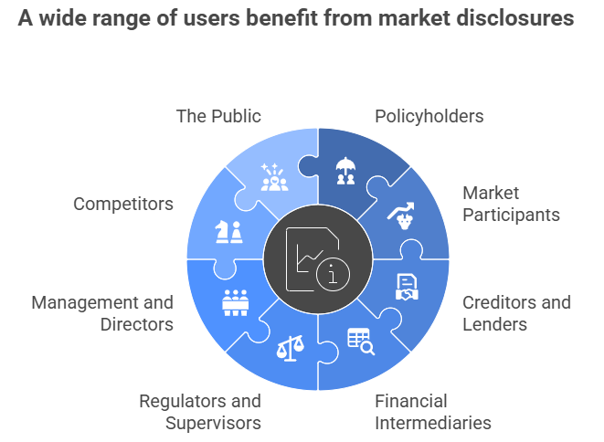
Users of Market Disclosures
Market disclosures serve a variety of internal and external stakeholders, providing distinct benefits that underpin market efficiency, corporate governance, and regulatory effectiveness.
The appropriateness of the type and level of disclosure should be considered against the user’s sophistication. Finding the right level and design of public risk disclosure is crucial to avoid undue costs or unintended consequences.
Notes:
https://notebooklm.google.com/notebook/91eed5e6-3220-4a1e-ae07-9f18a292d44b

Slide 13
Types of Market Disclosures
13

Slide 14
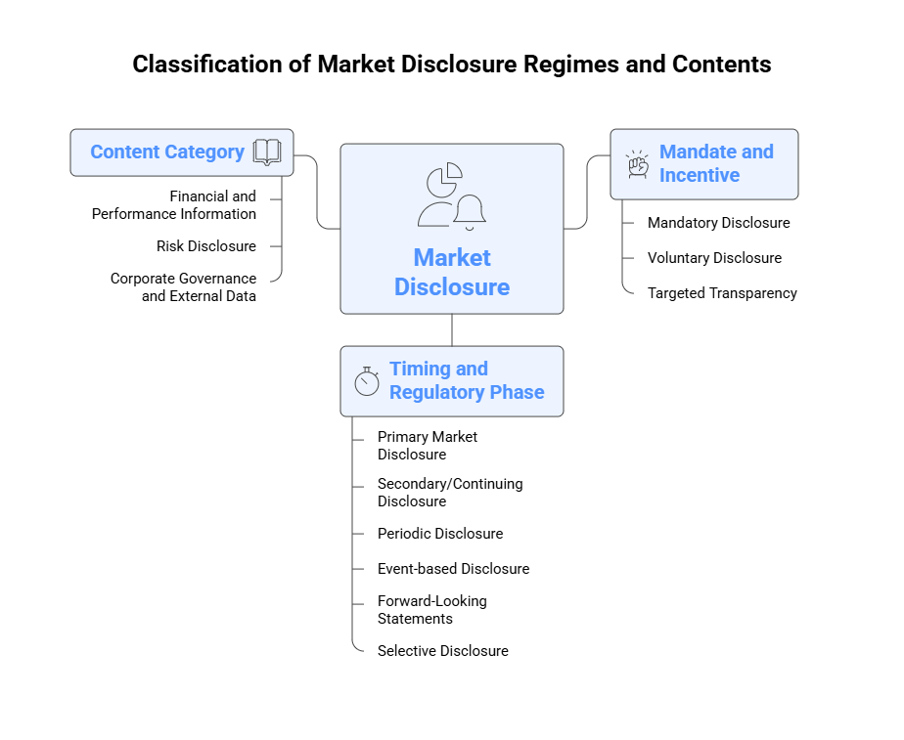
Types of Market Disclosures
Market disclosure can be categorised along several dimensions based on their mandatory nature, audience, content, and quality. Mandated disclosure remains the most common disclosures, enabling standardisation and filling the gap left by suboptimal voluntary disclosure. Disclosure content is increasingly becoming granular and specialised, extending far beyond traditional financial statements to encompass specific risks (e.g., climate risk, technical insurance risk) and governance practices.
Organised into categories covering financial performance, risk exposures, and corporate governance structure.
Insurance Core Principle (ICP) 20 requires insurers to publicly disclose detailed information on their:
  Company profile (e.g. nature of its business, corporate structure, key business segments, etc.)
  Corporate governance
  Technical provisions
  Risk exposures (insurance, investment, liquidity)
  Capital adequacy
  Financial performance
Disclosures classified based on the degree of regulatory compulsion and the resulting incentives for disclosure.
Distinguish between information legally required and that voluntarily provided by the reporting entity.
Categorisation by the time-related context in which the information is released, primarily distinguishing between initial offering and continuing obligations.
Notes:
https://notebooklm.google.com/notebook/91eed5e6-3220-4a1e-ae07-9f18a292d44b

Slide 15
Market Disclosures Metrics
15

Slide 16
Market Disclosure Metrics
The market disclosure landscape requires reporting on a diverse range of quantitative and qualitative metrics to satisfy the information needs of various stakeholders, including policyholders, investors, and regulators.
Market disclosure metrics span financial performance, capital adequacy, risk exposure, operational efficiency, and customer conduct among others.
Metric | Examples
Core Financial Viability and Capital Adequacy Metrics | Solvency Ratio Capital Available Capital Required
Premium & Market Share | Premium - Gross & Net Written Premium - New Business, Renewal Premium - Single, recurring Market Share by Company, Product Line
Technical Performance and Profitability Ratios | Profit After Tax (PAT) Ratios (Claims / Loss, Commission, Expenses, Combined) Return on Equity (ROE) Return on Assets (ROA) Embedded Value (EV), Value of New Business (VNB)
Investment & Asset | Total Assets Asset Allocation by Class Investment Yield/Returns Duration Mismatch
Metric | Examples
Policyholder Behaviour, Market Conduct and Customer Protection Metrics | Persistency Ratio Policy Renewal Rate (Non-life) Claims – volume, type, settlement ratio, processing time, rejection ratio Complaints & Disputes – Policy Cancellations & Mis-selling Incidents Net Promoter Scores (NPS)
Technical Provisions | Technical Provisions (Total) Best Estimate Liabilities Risk Margin Claims Outstanding, IBNR Reserves
Reinsurance Disclosures | Reinsurance Cessions, Recoverables, Retention Ratio Reinsurance Counterparty Risk Top Reinsurance Partners Reinsurance Program Structure
1
5
2
3
6
7
4
Notes:
https://notebooklm.google.com/notebook/91eed5e6-3220-4a1e-ae07-9f18a292d44b

Slide 17
Market Disclosure Metrics
The market disclosure landscape requires reporting on a diverse range of quantitative and qualitative metrics to satisfy the information needs of various stakeholders, including policyholders, investors, and regulators.
Market disclosure metrics span financial performance, capital adequacy, risk exposure, operational efficiency, and customer conduct among others.
Metric | Examples
Business in force & coverage disclosures | Number of Policyholders , Policies in Force Sum Assured/Insured Business volume (Premium) – New, inforce, lapsed, terminated
Operational & Governance Disclosures | Board Composition Key Management Personnel Related Party Transactions Audit Opinion Regulatory Actions/Penalties
Climate Risk & ESG Disclosures | Climate Risk Exposure Carbon Footprint Green/Sustainable Investment
Regulatory Compliance Disclosures | Regulatory Capital Compliance Investment Limit Compliance Actuarial Certification Product Filing Status Licensing Status
Metric | Examples
Stress Testing & Scenario Analysis | Stress Test Results Scenario Analysis Catastrophe Modeling Interest Rate Sensitivity Equity Market Crash Scenario Pandemic Scenario Cyber Attack Scenario
Market Concentration & Structure | Market Concentration Index (HHI) Top 5/10 Insurer Market Share Number of Insurers by Type Foreign vs. Domestic Ownership New Entrants/Exits Mergers & Acquisitions Public vs. Private Sector Share
Penetration & Density Indicators | Insurance Penetration – Total, Life, non-life Insurance Density Penetration – Total, Life, non-life Protection Gap Coverage Ratio
8
12
9
13
10
11
14
Notes:
https://notebooklm.google.com/notebook/91eed5e6-3220-4a1e-ae07-9f18a292d44b

Slide 18
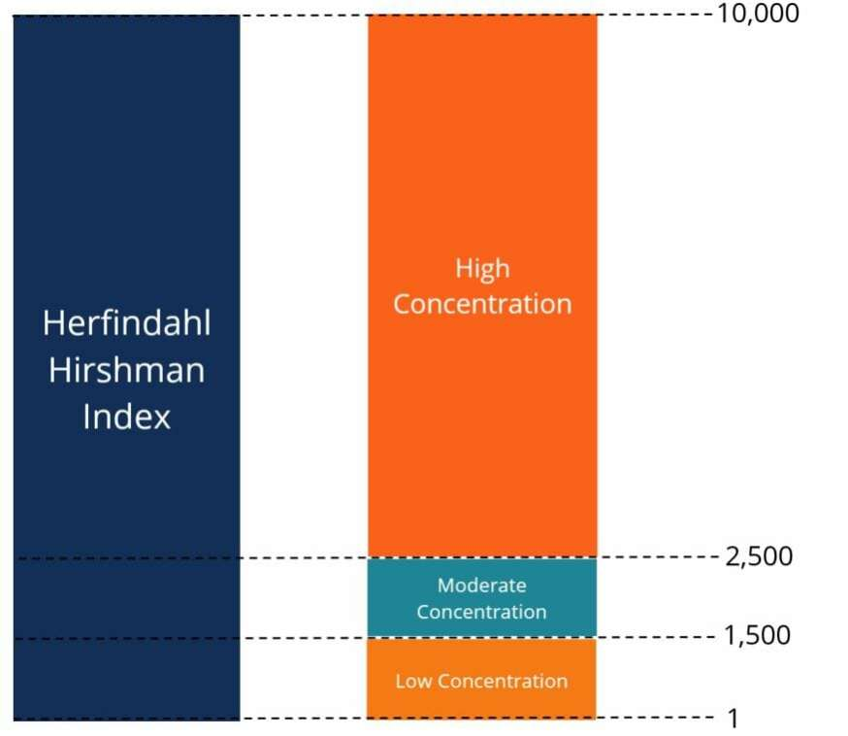
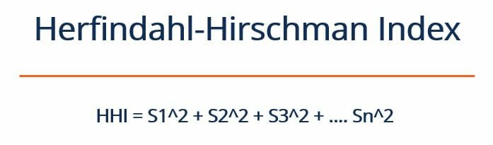
Herfindahl-Hirschman Index (HHI)
Measures the size of companies relative to the size of the industry they are in and assesses the level of competitiveness/market concentration.
( ) X 10,000
Where:
S1, S2, etc… – refers to the percentage market share that various companies hold in the given industry
Kenya Life Insurance: HHI of 1,103 as at 31 December 2024
Kenya General Insurance: HHI of 545 as at 31 December 2024
Market Share by Gross Written Premium
Source: IRA 31 December 2024 Annual Report
Notes:
https://notebooklm.google.com/notebook/91eed5e6-3220-4a1e-ae07-9f18a292d44b

Slide 19
Disadvantages/ Risks of Market Disclosures
19

Slide 20
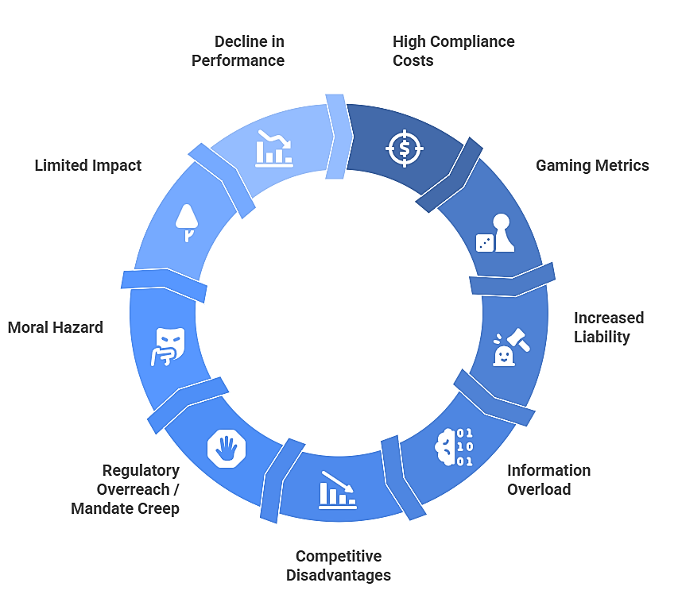
Disadvantages/ Risks of Market Disclosures
Mandatory market disclosures, while a fundamental pillar of financial regulation designed to mitigate information asymmetry and enhance market efficiency, are inherently constrained by various costs and unintended consequences.
Notes:
https://notebooklm.google.com/notebook/91eed5e6-3220-4a1e-ae07-9f18a292d44b

Slide 21
Disadvantages/ Risks of Market Disclosures
Various costs and unintended consequences inherently constrain mandatory market disclosures.
 | Disadvantage /Risk | Description
1 | High Compliance & Implementation Costs | Significant resources needed, potentially burdening smaller insurers. Reduced Market Entry. Reduced Product Innovation.
2 | Risk of Gaming Metrics | Firms may manipulate metrics to appear better, especially on voluntary disclosures.
3 | Increased Liability | More disclosure leads to greater legal risk. Insurers may become overly cautious, disclose minimal “safe” metrics, or resist new disclosure requirements.
4 | Information Overload | Too much data can overwhelm users, reducing clarity and sub-par decisions made. Key signals can be lost amidst irrelevant or unrelated metrics. Consumers or analysts may ignore disclosures.
5 | Competitive Disadvantages | Revealing strategies (e.g. expense structure, product pricing, Distribution Channels, reinsurance arrangements, etc. )can reduce competitive edge. Insurers could push back or lobby to limit disclosure scope.
Notes:
https://notebooklm.google.com/notebook/91eed5e6-3220-4a1e-ae07-9f18a292d44b

Slide 22
Disadvantages/ Risks of Market Disclosures
Various costs and unintended consequences inherently constrain mandatory market disclosures.
 | Disadvantage /Risk | Description
6 | Regulatory Overreach / Mandate Creep | Disclosure regimes may expand beyond the original scope. Regulators risk being drawn into detailed oversight, diluting focus on prudential supervision or conduct interventions.
7 | Moral Hazard | If disclosure enhances access to capital, some firms might take on riskier underwriting to grow premium base.
8 | Limited Impact | Disclosure may be unused in markets with weak literacy. Disclosure without complementary education/intermediation may yield little behavior change.
9 | Decline in Operating Performance | Firms forced to increase disaggregated segment reporting can experience a decline in operating performance, specifically driven by lower sales growth and reduced profit margins.
10 | Cross-Jurisdictional Complexity | Multinational insurers face conflicting disclosure requirements across markets, increasing complexity and cost
Notes:
https://notebooklm.google.com/notebook/91eed5e6-3220-4a1e-ae07-9f18a292d44b

Slide 23

Market Disclosure in Action
Persistency in India
23

Slide 24
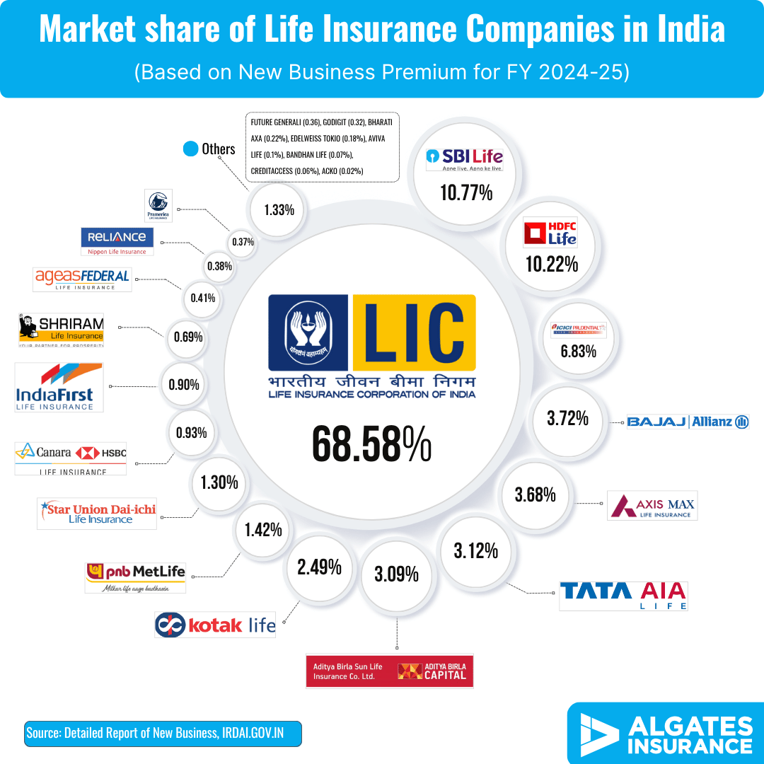
India Life Insurance Market Overview
The Indian life insurance market is characterized by robust growth potential, structural dominance by the public sector, and persistent challenges related to policy retention, set within an evolving regulatory framework focused on enhancing penetration and digital adoption.
Dominance of Life Sector: Life share of total premium volume stood at 75.60% in 2022.
Some Market Stats Summary
Total Premium Volume
₹8.30 lakh crore (USD 100b)
(FY 2023-24)
Number of Insurers
26 (1 Public ; 25 Private)
Historical Growth
Historic compound annual growth rate (CAGR) of 16.5% over a period of 17 years
Global Standing and Position
Ranked the 10th largest insurance market in the world in 2022 (and 9th in life insurance business in 2021)
Low Penetration Rates
2.8% in 2023
Notes:
https://notebooklm.google.com/notebook/91eed5e6-3220-4a1e-ae07-9f18a292d44b

Slide 25
Persistency in India:
Life insurance persistency in India refers to the percentage of policies and premiums remaining in force, reflecting the continuous payment of renewal premiums by policyholders without the policies lapsing, canceling or being surrendered. It is considered a vital indicator of policy and insurer performance.
Measurement
The persistency ratio is typically measured at various intervals of 13th, 25th, 37th, 49th, and 61st months.
13th month indicator satisfaction and the
61st month indicator for long-term loyalty.
Key factors contributing to low persistency include:
Mis-selling and Unsuitable Sales Practices
Financial Constraints and Economic Environment e.g. job loss, salary cuts, financial distress, increased inflation.
Agent Attrition and Service Issues e.g. managing "orphan policies“.
Product Design and Performance – policyholders lapse if they deem the product is unsatisfactory (e.g., bonus rates or fund value not accumulating as expected), or if they perceive the product as irrelevant or unsuited to their long-term needs.
Distribution Channel - persistency rates can be channel-specific.
Recent Improvements
The industry has recently shown a positive trajectory.
Aggregate data for six leading players (Bajaj Allianz Life, HDFC Life, ICICI Pru Life, LIC, SBI Life, and TATA AIG Life) demonstrates a consistent improvement across various durations between 2019-20 and 2023-24:
  13-Month (one-year) persistency: Increased significantly for the six leading players from 71.04% in 2019-20 to 79.36% in 2023-24, suggesting insurers are becoming more effective in ensuring customers renew their policies after the crucial first year. Regulator (IRDAI) targeting 90%.
  61-Month (five-year) persistency: Crossed the 50% milestone, rising from 43.80% in 2019-20 to 51.12% in 2023-24, indicating better long-term retention. Regulator (IRDAI) targeting 65%.
Notes:
https://notebooklm.google.com/notebook/91eed5e6-3220-4a1e-ae07-9f18a292d44b

Slide 26
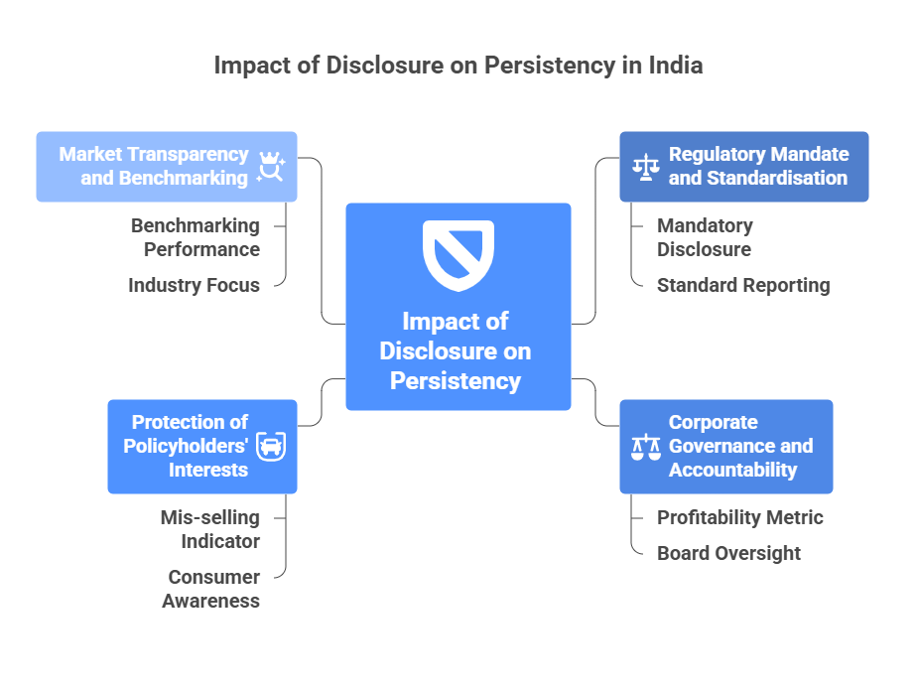
Persistency in India: Impact of Disclosure
The disclosure of persistency ratios in the Indian life insurance market plays a mandatory, dual role, serving both regulatory enforcement and as a key metric for corporate governance and market transparency.
Persistency market disclosure acts as a publicly visible performance report card.
The disclosure forces insurers to align their sales and service quality with long-term policy retention objectives to maintain credibility and financial stability.
India’s market evidence shows strong correlation between persistency rates and solvency ratios
Notes:
https://notebooklm.google.com/notebook/91eed5e6-3220-4a1e-ae07-9f18a292d44b

Slide 27
Persistency in India: Impact of Disclosure
Regulatory Mandate and Standardisation
Impact on Corporate Governance and Accountability
Protection of Policyholders' Interests and Combating Mis-selling
Impact on Market Transparency and Benchmarking
Measurement Metrics
Persistency ratios are officially measured by the regulator in terms of the number of policies in force after stipulated periods. These intervals are consistently set at the end of the 13th, 25th, 37th, 49th, and 61st months.
Key Profitability Metric
Mandating persistency disclosure highlights the importance of enabling insurers to recoup the substantial upfront acquisition costs incurred when a policy is sold.
Mis-selling & Poor Product Design Indicator
Persistency disclosures can draw attention to poor quality of the original sale, signaling areas where sales practices and customer education need improvement. Could also signal product design issues.
Benchmarking Performance
Industry analysts and stakeholders can benchmark the performance of individual insurers and the sector as a whole against global standards.
Standardisation of Reporting
Regulator has provided a standard formula to be followed by all life insurers to remove ambiguities in reporting persistency across the industry.
Board Oversight
The disclosure requirement falls under the overall governance framework mandated by IRDAI's Corporate Governance Guidelines for Insurers. The Board of Directors must ensure that information related to key operating ratios, including the persistency ratio, is disclosed in the annual accounts.
Consumer Awareness
Public disclosures encourages consumers to choose insurers with higher retention rates, promoting healthier competition.
Industry Focus
The visibility of persistency trends provides empirical evidence of positive trajectory and encourages further efforts to address the persistent challenge of early lapses.
Notes:
https://notebooklm.google.com/notebook/91eed5e6-3220-4a1e-ae07-9f18a292d44b

Slide 28
Persistency in India: Impact of Disclosure
Regulatory Mandate and Standardisation
Impact on Corporate Governance and Accountability
Protection of Policyholders' Interests and Combating Mis-selling
Impact on Market Transparency and Benchmarking
Mandatory Disclosure
Insurers engaged in the life insurance business are explicitly required to disclose the persistency ratio of policies sold by them in their annual accounts or financial statements.
Monitoring Service Quality
A high persistency ratio implies that policyholders are satisfied with the insurer's products, customer service, after-sales service, and overall product utility. Disclosure serves as a vital indicator of the quality of the sale and the future growth of the insurer.
Driving Strategic Intervention
Poor persistency rates motivate the regulator and insurers to take corrective action, e.g. insisting on mandatory sales illustrations and needs-based selling to capture customer goals and reduce lapsation caused by misunderstanding.
Notes:
https://notebooklm.google.com/notebook/91eed5e6-3220-4a1e-ae07-9f18a292d44b

Slide 29

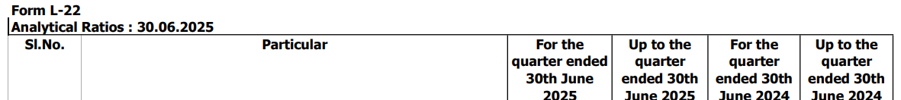
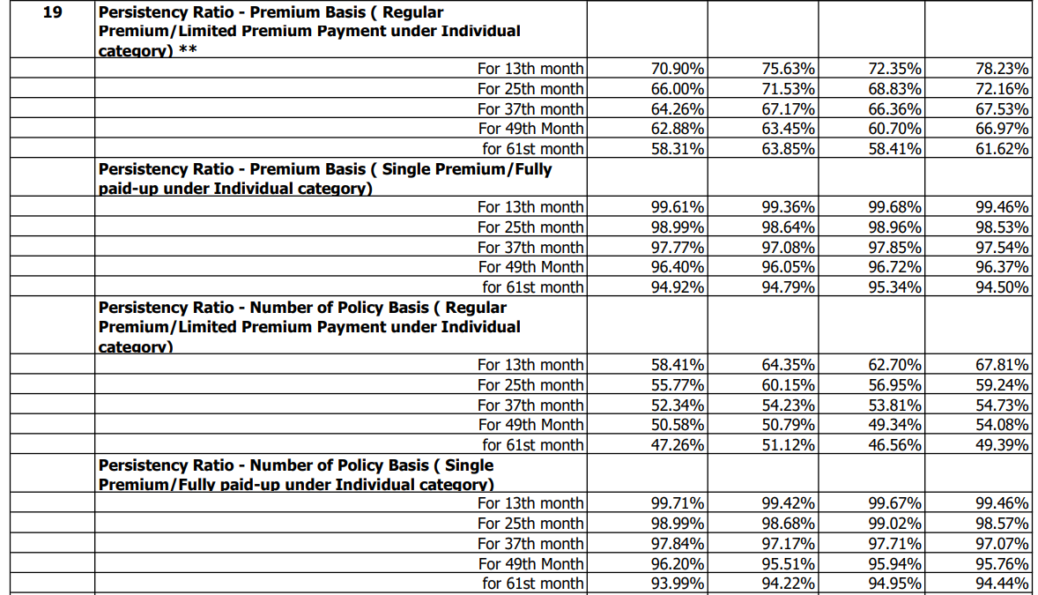
Persistency in India: Disclosure Example 1
1
Life Insurance Company (LIC) of India
2
3
4
Notes:
https://notebooklm.google.com/notebook/91eed5e6-3220-4a1e-ae07-9f18a292d44b

Slide 30

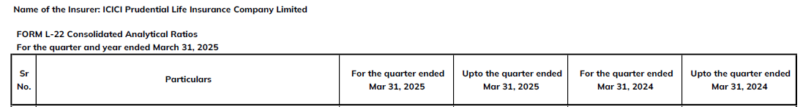
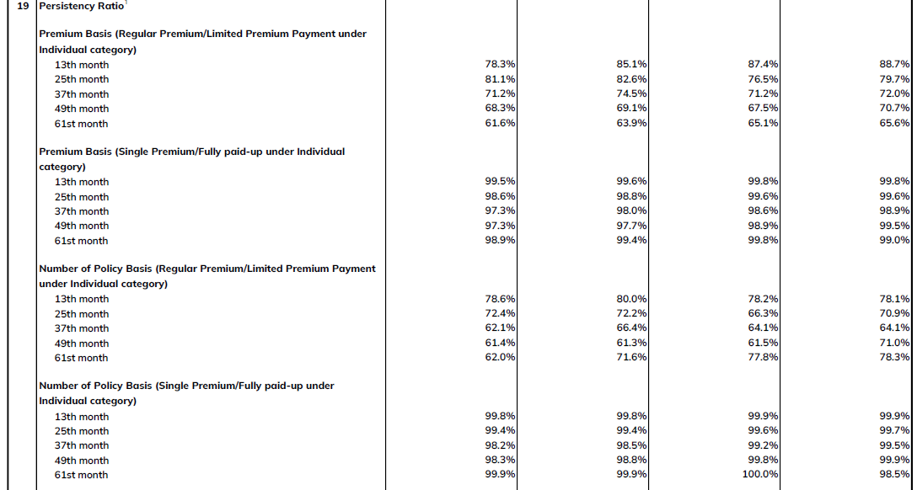
Persistency in India: Disclosure Example 2
ICICI Prudential Life Insurance
1
2
3
4
Notes:
https://notebooklm.google.com/notebook/91eed5e6-3220-4a1e-ae07-9f18a292d44b

Slide 31
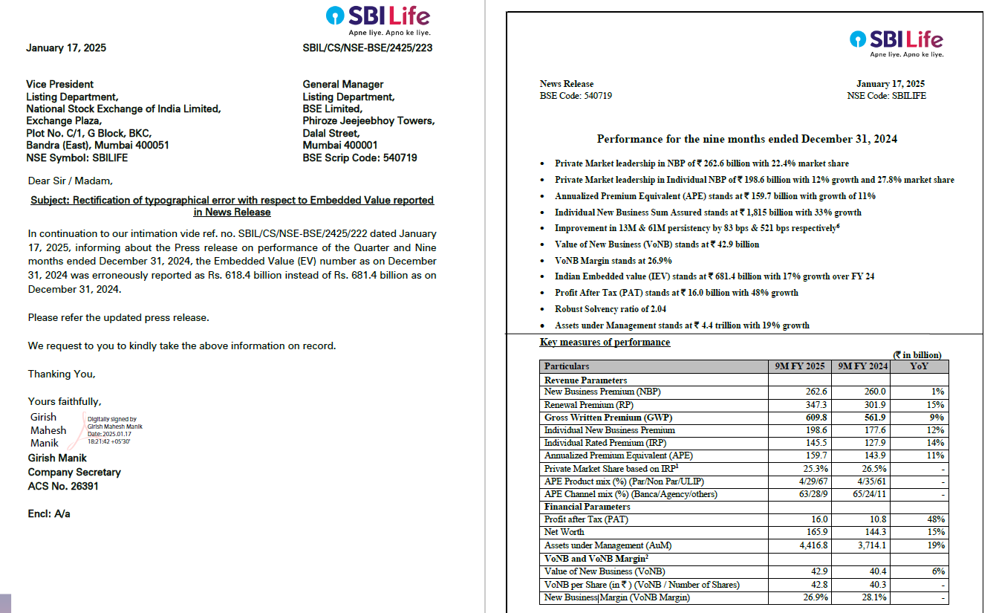
Persistency in India: Disclosure Example 3
2
1
Notes:
https://notebooklm.google.com/notebook/91eed5e6-3220-4a1e-ae07-9f18a292d44b

Slide 32

Market Disclosure in Action
Silicon Valley Bank
32

Slide 33
Silicon Valley Bank
Silicon Valley Bank (SVB) was the 16th largest commercial bank in the United States (U.S) that collapsed in March 2023, marking the second-largest bank failure in U.S. history. A complex combination of internal and external factors, including market disclosure, drove the bank’s collapse.
Internal Factors (Management and Risk Strategy Failures)
High-risk investment strategy on interest-sensitive long-term fixed-income securities (U.S. Treasuries and mortgage-backed securities). SVB failed to manage basic interest rate risk and had a deep ALM mismatch.
Depositor Concentration Risk - client base predominantly serving customers in the technology and venture capital (VC) industries.
Over-reliance on uninsured deposits - approximately 94% of SVB’s total deposits were uninsured. This liability structure was susceptible to rapid runs.
Fundamental shortcomings in risk management - SVB made mistakes in risk management, failing to evaluate credit risk and asset quality properly. The CRO position was vacant for 8 months in 2022.
Poor liquidity risk management practices - The bank failed its own internal liquidity stress tests (ILST) and did not have workable plans to access liquidity in times of stress.
External, Systemic, and Regulatory Factors
Federal Reserve Interest Rate Hikes - The interest rate hike policy (raising rates to around 5% in March 2022) led to the devaluation of SVB's large holdings of fixed-income securities, causing the value of the bonds SVB purchased to decline because bond prices move inversely to interest rates.
Economic Downturn - The global economic recession and external factors such as the COVID-19 pandemic led to a sharp decline in loan demand and revenue in the technology industry.
Changing Tech Industry Dynamics - the sector was no longer hot, and money started to flow out, causing fluctuations in deposits. This caused SVB’s VC-backed clients to draw down their cash reserves to fund their operations.
Digitalisation and Social Media-Driven Bank Run - Social media enabled depositors to instantly spread concerns, and technology allowed immediate withdrawals, fundamentally changing the speed of bank runs.
Regulatory Shortcomings and Tailoring - The bank had regulatory exemptions to stringent requirements like supervisory stress testing.
Notes:
https://notebooklm.google.com/notebook/91eed5e6-3220-4a1e-ae07-9f18a292d44b

Slide 34
Silicon Valley Bank
The topic of market disclosures in the case of Silicon Valley Bank (SVB) and its holding company, SVB Financial Group (SVBFG), reveals that the nature of what was disclosed (or potentially shielded from full disclosure) played a critical role in triggering the rapid bank run and subsequent collapse.
The Disclosure That Triggered The Collapse
The collapse was immediately sparked by a specific market announcement made by SVB Financial Group (SVBFG) on March 8, 2023.
Key items disclosed were:
  Sale of Securities at a Loss – SVBFG announced plans to restructure its balance sheet, including the sale of $21 billion in Available-for-Sale (AFS) securities at an after-tax loss of $1.8 billion.
  Capital Raise - The announcement also included seeking to raise $2.25 billion in capital.
The impact of the public disclosure was:
  It sent a market signal that the bank was in immediate financial distress and needed capital, causing panic among major venture capital firms and investors.
  The disclosure triggered an unprecedented bank run.
Lack of Transparency: Concealing Risks
Held-to-Maturity (HTM) Classification: SVB held large amounts of long-term investment securities, such as U.S. Treasuries, under the HTM designation. These assets were carried at their historical cost, meaning that massive unrealised losses caused by the rapid rise in interest rates were hidden from immediate regulatory capital calculations. The bank was able to opt out of requirements to recognise these unrealised losses in its regulatory capital, thereby overstating its resilience.
Contradictory Statements: SVB publicly touted having "solid risk management practices and effective controls" in its financial disclosures, despite internally failing to manage basic interest rate and liquidity risks.
Internal Oversight Failure: The full board of directors did not receive adequate information about SVBFG’s liquidity issues from management until November 2022, despite deteriorating financial conditions.
Notes:
https://notebooklm.google.com/notebook/91eed5e6-3220-4a1e-ae07-9f18a292d44b

Slide 35
Silicon Valley Bank
Could Market disclosures have prevented the collapse?
Market disclosures alone were unlikely to prevent the collapse, as the crisis was driven by underlying systemic vulnerabilities amplified by digital speed.
Viewpoint
Supporting Evidence from the Sources
No, Disclosure Alone Wasn't Enough
The core issues were fundamental managerial weaknesses, highly concentrated funding (uninsured deposits), and a deep asset-liability mismatch.
The Speed Factor
The run was accelerated by social media and technology. Technology removed friction points, allowing coordinated withdrawals at an unprecedented speed and magnitude that traditional liquidity models could not anticipate.
Yes, Stronger Regulation Might Have
Stronger regulatory rules, specifically requiring the recognition of unrealised losses on HTM securities in regulatory capital, SVB's weakness would have been apparent sooner.
Increased capital and liquidity requirements might have bolstered resilience or forced SVBFG to take corrective action much earlier, potentially preventing the failure.
Notes:
https://notebooklm.google.com/notebook/91eed5e6-3220-4a1e-ae07-9f18a292d44b

Slide 36
The Actuarial Role In Market Disclosure
36

Slide 37
The Actuarial Role In Market Disclosure
Traditional Role: Actuaries calculate the numbers required by regulations
Policy Architect Role: Actuaries help design what should be disclosed, how, and why
1
Designing Meaningful & Comparable Disclosures
2
Building Public Trust Through Engagement & Communication
Metric Selection & Design
Identify KPIs revealing true financial health, consumer outcomes, and risk exposure
Propose relevant, interpretable KPIs / metrics
Build metrics that cannot be gamed
Public Engagement
Translate complex actuarial outputs into clear communication for non-expert users
Co-create infographics, FAQs, dashboards for the public
Communication over Volume
Prioritise clear summary disclosures over data dumps
More disclosure ≠ better decisions if users are overwhelmed
Materiality-based disclosure with "comply or explain" flexibility
Education & Capacity Building
Policy only works if people can implement it
Train boards, regulators, journalists, and other stakeholders on interpreting disclosures
Standardisation
Develop formats, templates, and actuarial methods
Drive consistent calculation and reporting practices across the market
Disclosure Governance
Recommend frequency, audit level, and comparability standards
Notes:
https://notebooklm.google.com/notebook/91eed5e6-3220-4a1e-ae07-9f18a292d44b

Slide 38
The Actuarial Role In Market Disclosure
Traditional Role: Actuaries calculate the numbers required by regulations
Policy Architect Role: Actuaries help design what should be disclosed, how, and why
3
Embedding Actuarial Input in Policy Processes
4
Future-Oriented Disclosure Leadership
Consultation & Co-Creation
Join policy working groups, review drafts, assess disclosure feasibility
Provide expert input on costs, data gaps, unintended consequences
Emerging / Frontier Risk Disclosures
Support development of disclosure frameworks for new and evolving risks
Feedback & Iteration
Use experience analysis to evaluate disclosure effectiveness and iterate
Notes:
https://notebooklm.google.com/notebook/91eed5e6-3220-4a1e-ae07-9f18a292d44b

Slide 39





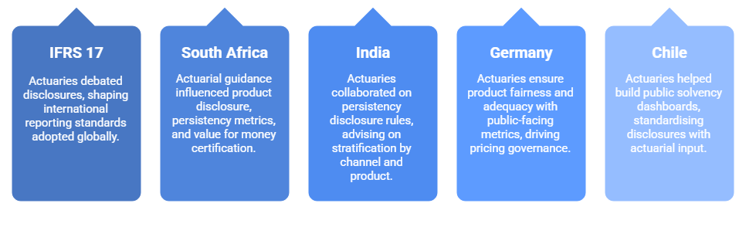
The Actuarial Role In Market Disclosure
Examples of Actuaries as Policy Architects in Market Disclosure
Notes:
https://notebooklm.google.com/notebook/91eed5e6-3220-4a1e-ae07-9f18a292d44b

Slide 40
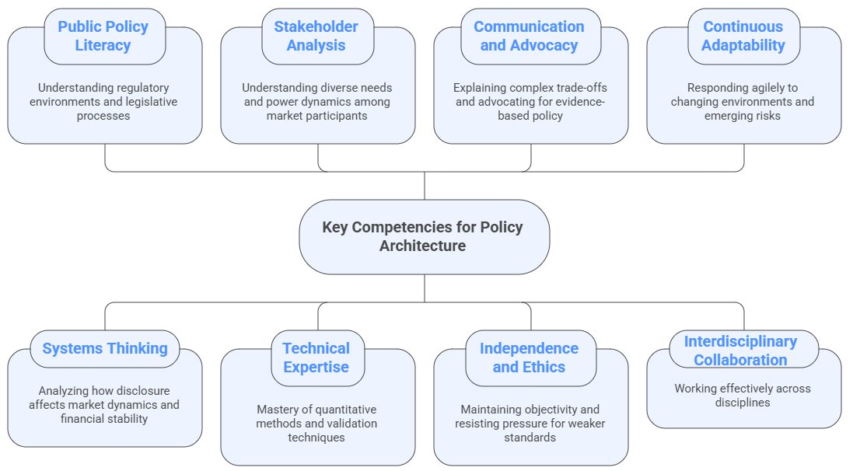
The Actuarial Role In Market Disclosure
Key Competencies for Policy Architecture
To serve as effective policy architects, competencies in technical expertise, risk and financial modelling, strategic business acumen, adherence to professional and communication standards, and others are required.
Notes:
https://notebooklm.google.com/notebook/91eed5e6-3220-4a1e-ae07-9f18a292d44b

Slide 41
A Case For Kenya
41

Slide 42
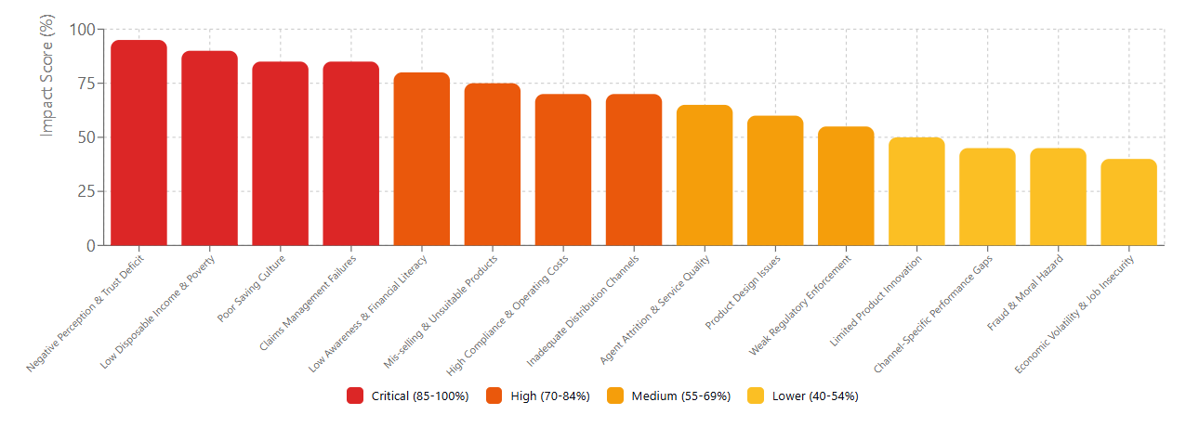
A Case For Kenya
Kenya Insurance Penetration: Research-Based Factor Analysis
Comprehensive synthesis of academic studies, regulatory reports, and industry analyses (2010-2025)
Analysis performed by claude.ai
Notes:
https://notebooklm.google.com/notebook/91eed5e6-3220-4a1e-ae07-9f18a292d44b

Slide 43
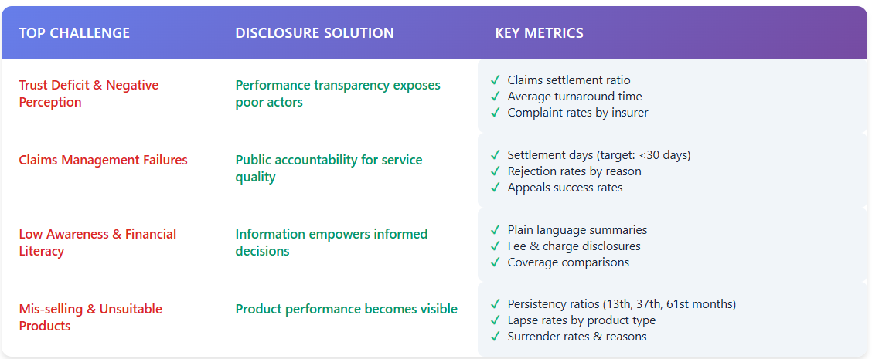
A Case For Kenya
How Market Disclosures Address Kenya's Insurance Penetration Challenges
Market disclosure = Low-cost, high-impact intervention addressing 8 of top 15 penetration barriers
A Data-Driven Solution to Build Trust, Transparency & Market Discipline
Analysis performed by claude.ai
Notes:
https://notebooklm.google.com/notebook/91eed5e6-3220-4a1e-ae07-9f18a292d44b

Slide 44
Conclusions & Recommendations
44

Slide 45






Conclusions & Recommendations
Key Takeaways:
Market disclosure is essential infrastructure - not just compliance
Design matters more than volume: India succeeded, SVB failed
Actuaries must evolve from calculators to policy architects
Potential Actions for Kenya:
IRA: Mandate consumer outcome metrics (persistency, claims settlement ratios) with phased rollout
TASK: Establish Market Disclosure Committee and develop Actuarial Practice Notes
Insurers: Invest in data infrastructure and view disclosure as competitive advantage, not burden
Notes:
https://notebooklm.google.com/notebook/91eed5e6-3220-4a1e-ae07-9f18a292d44b

Slide 46

Market Disclosure: Who knows what?
https://youtu.be/Pst9FCWkKTQ
46

Slide 47
The End
Questions & Comments
47

Slide 48
Sources
Academic Research and Published Periodicals
    Published Research Articles / Journal Articles
    Systematic Literature Reviews / Review Articles
    Working Papers / Staff Reports
Regulatory, Policy, and Standard-Setting Material
    Regulatory Manuals, Standards, Handbooks and Guides
    Regulatory Documents/Filings/Reports
    Actuarial Professional Standards
  Corporate, Industry, and Technical Data Sources
    Company reports, e.g annual financial statements, Corporate/Sustainability Reports
    Industry Reports and Analysis
    Company Websites
Notes:
https://notebooklm.google.com/notebook/91eed5e6-3220-4a1e-ae07-9f18a292d44b

Slide 49
49
Notes:
https://notebooklm.google.com/notebook/91eed5e6-3220-4a1e-ae07-9f18a292d44b

